Slide 1
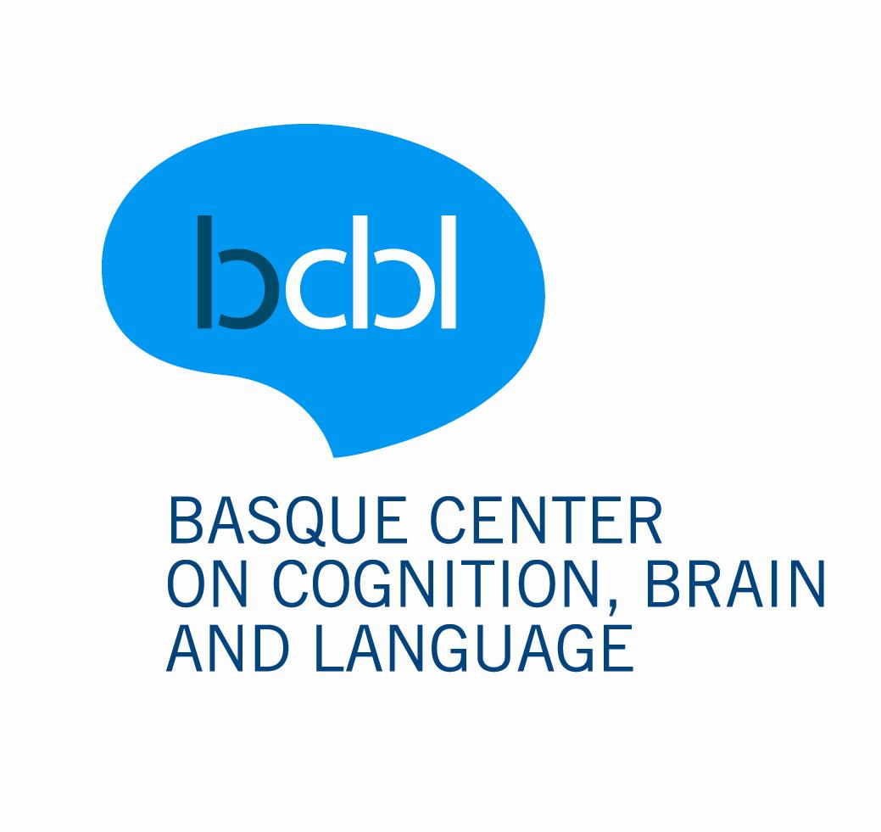

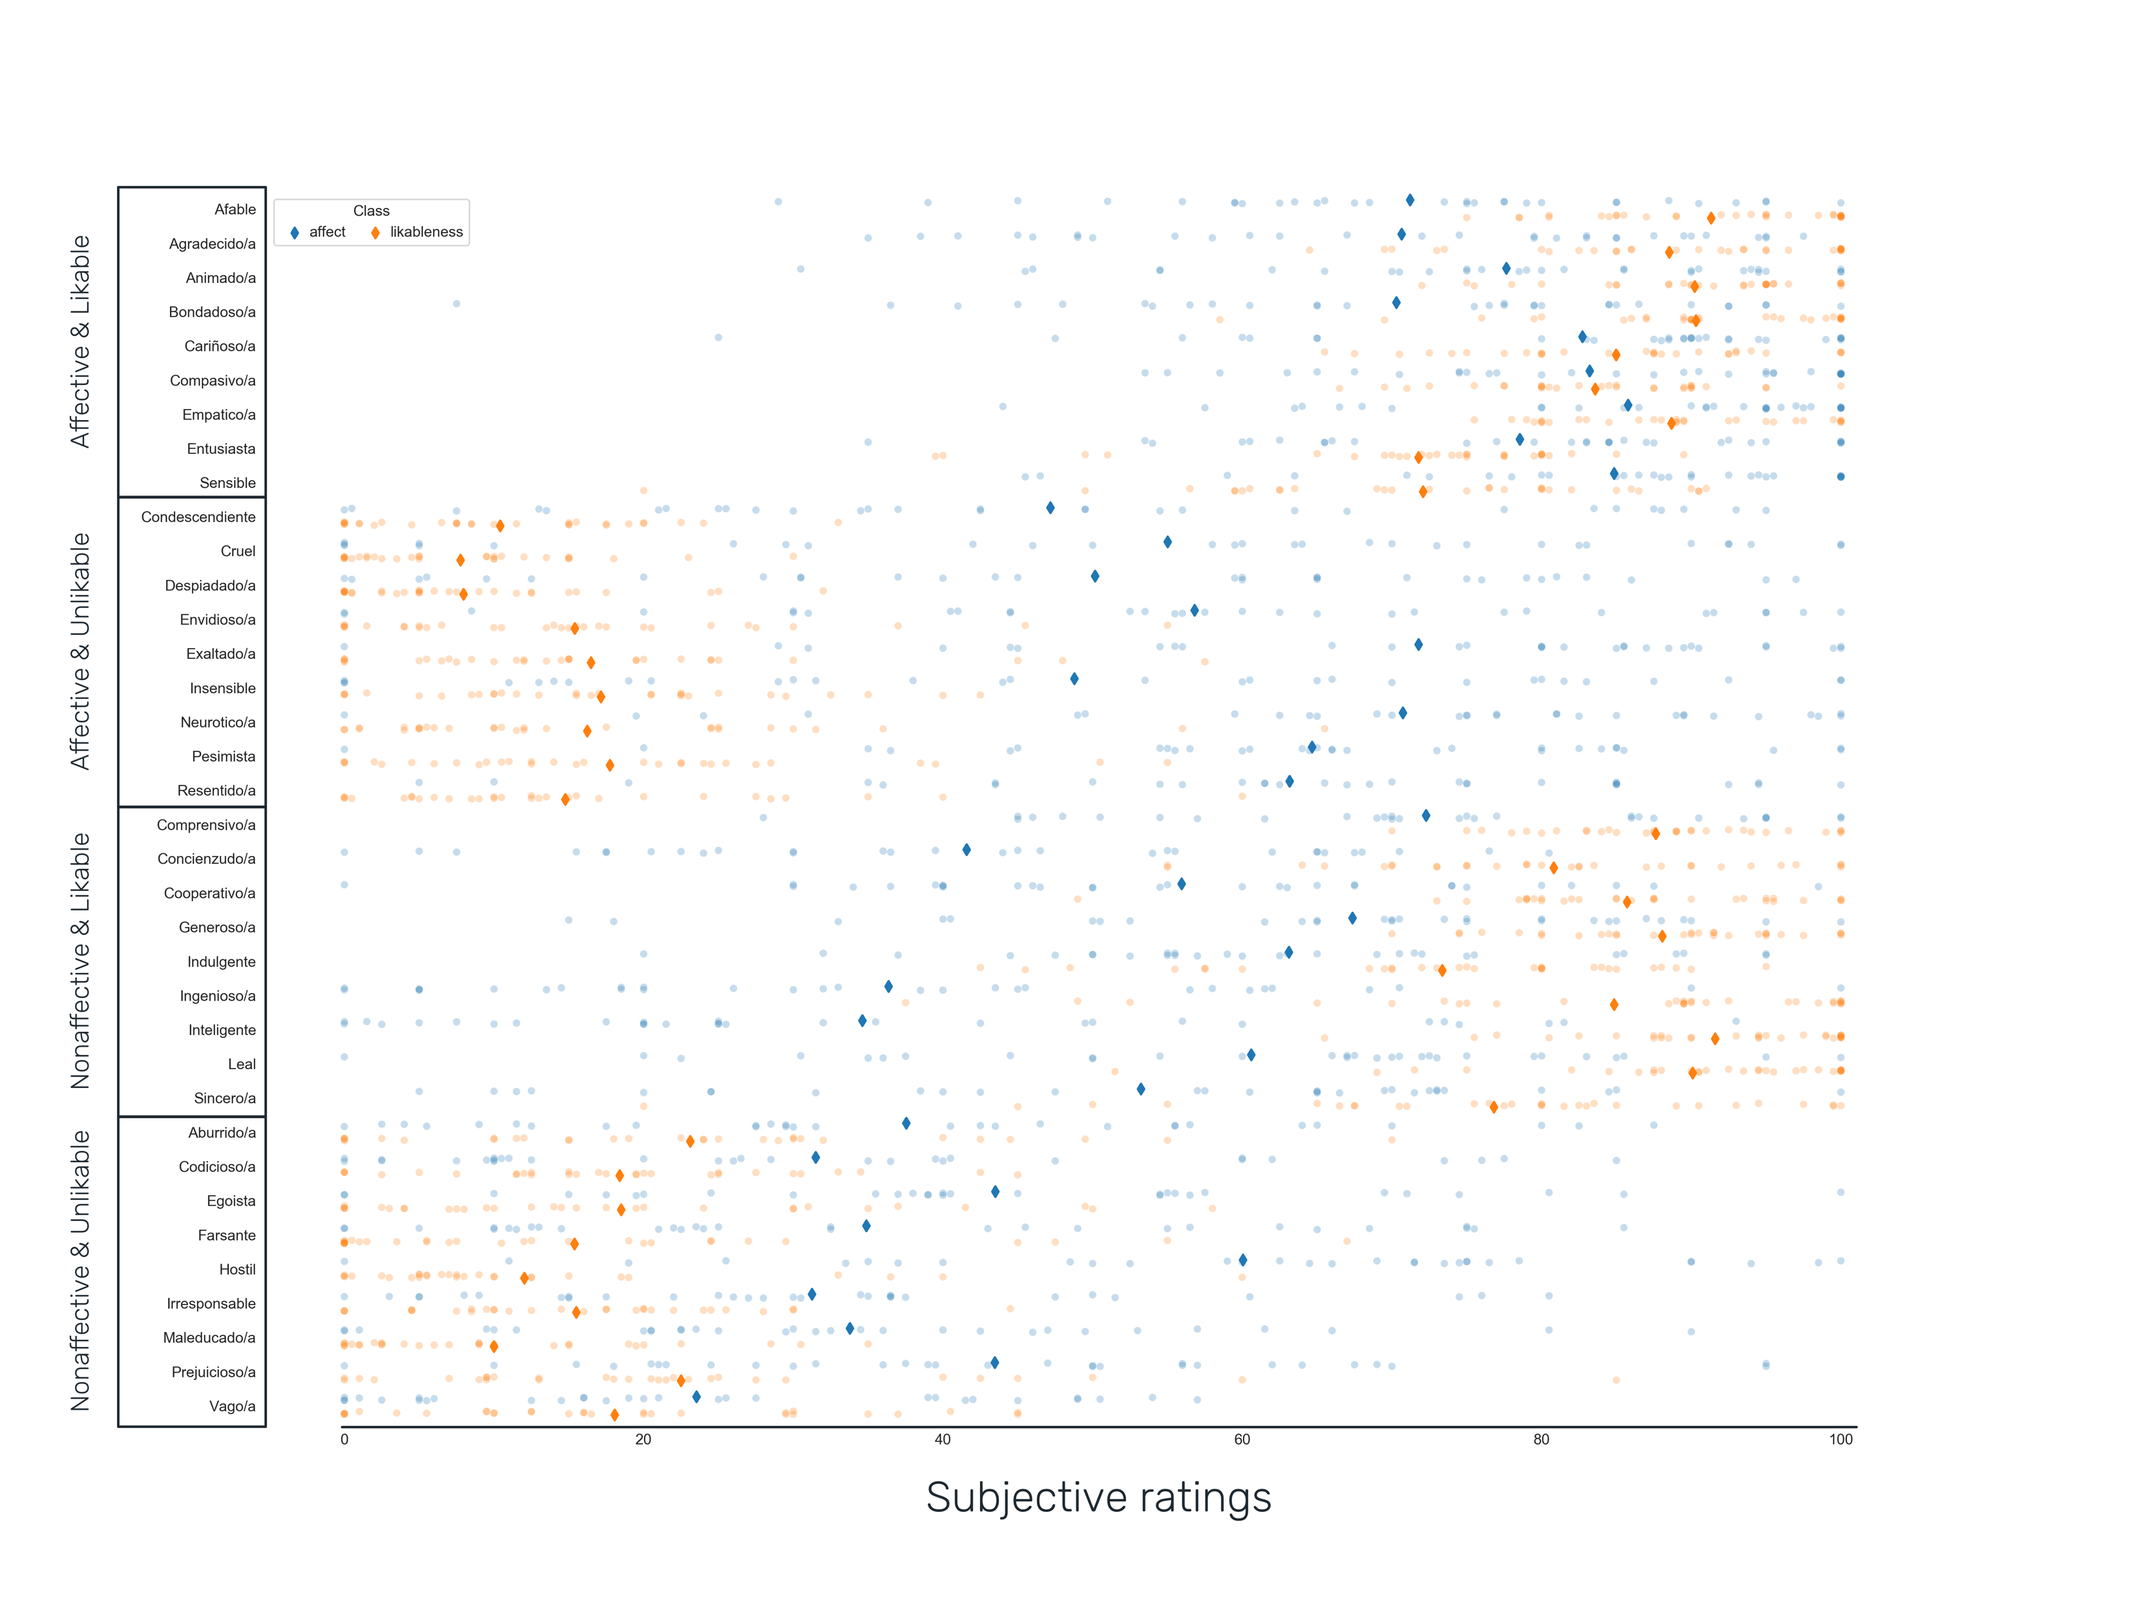

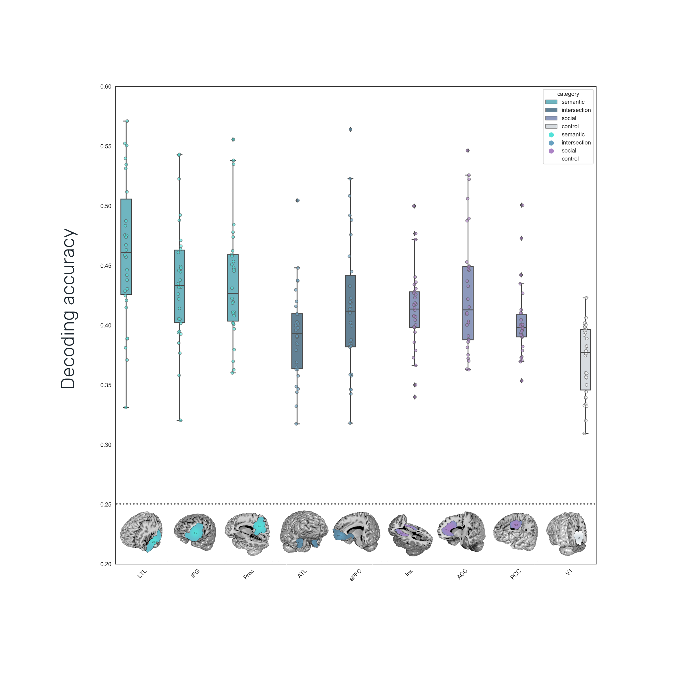

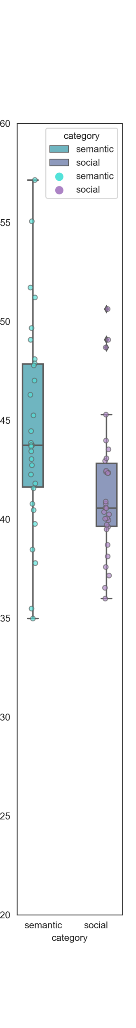
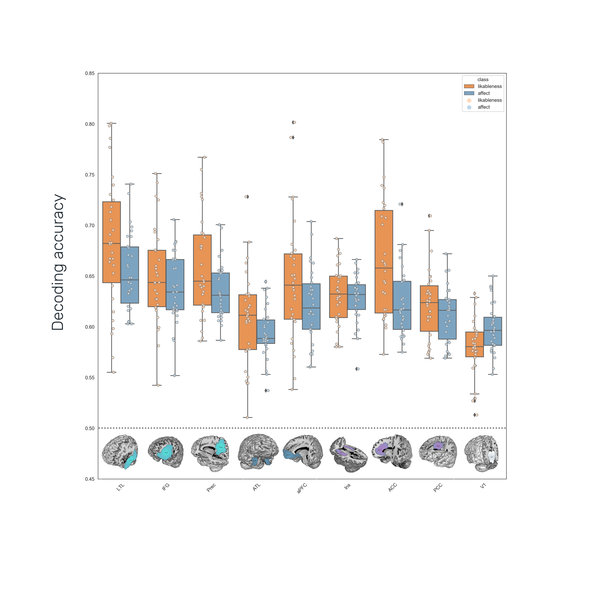
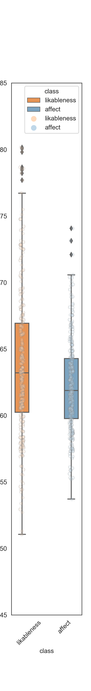
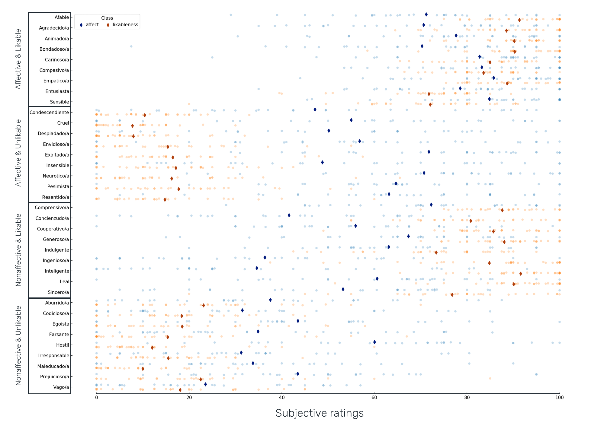
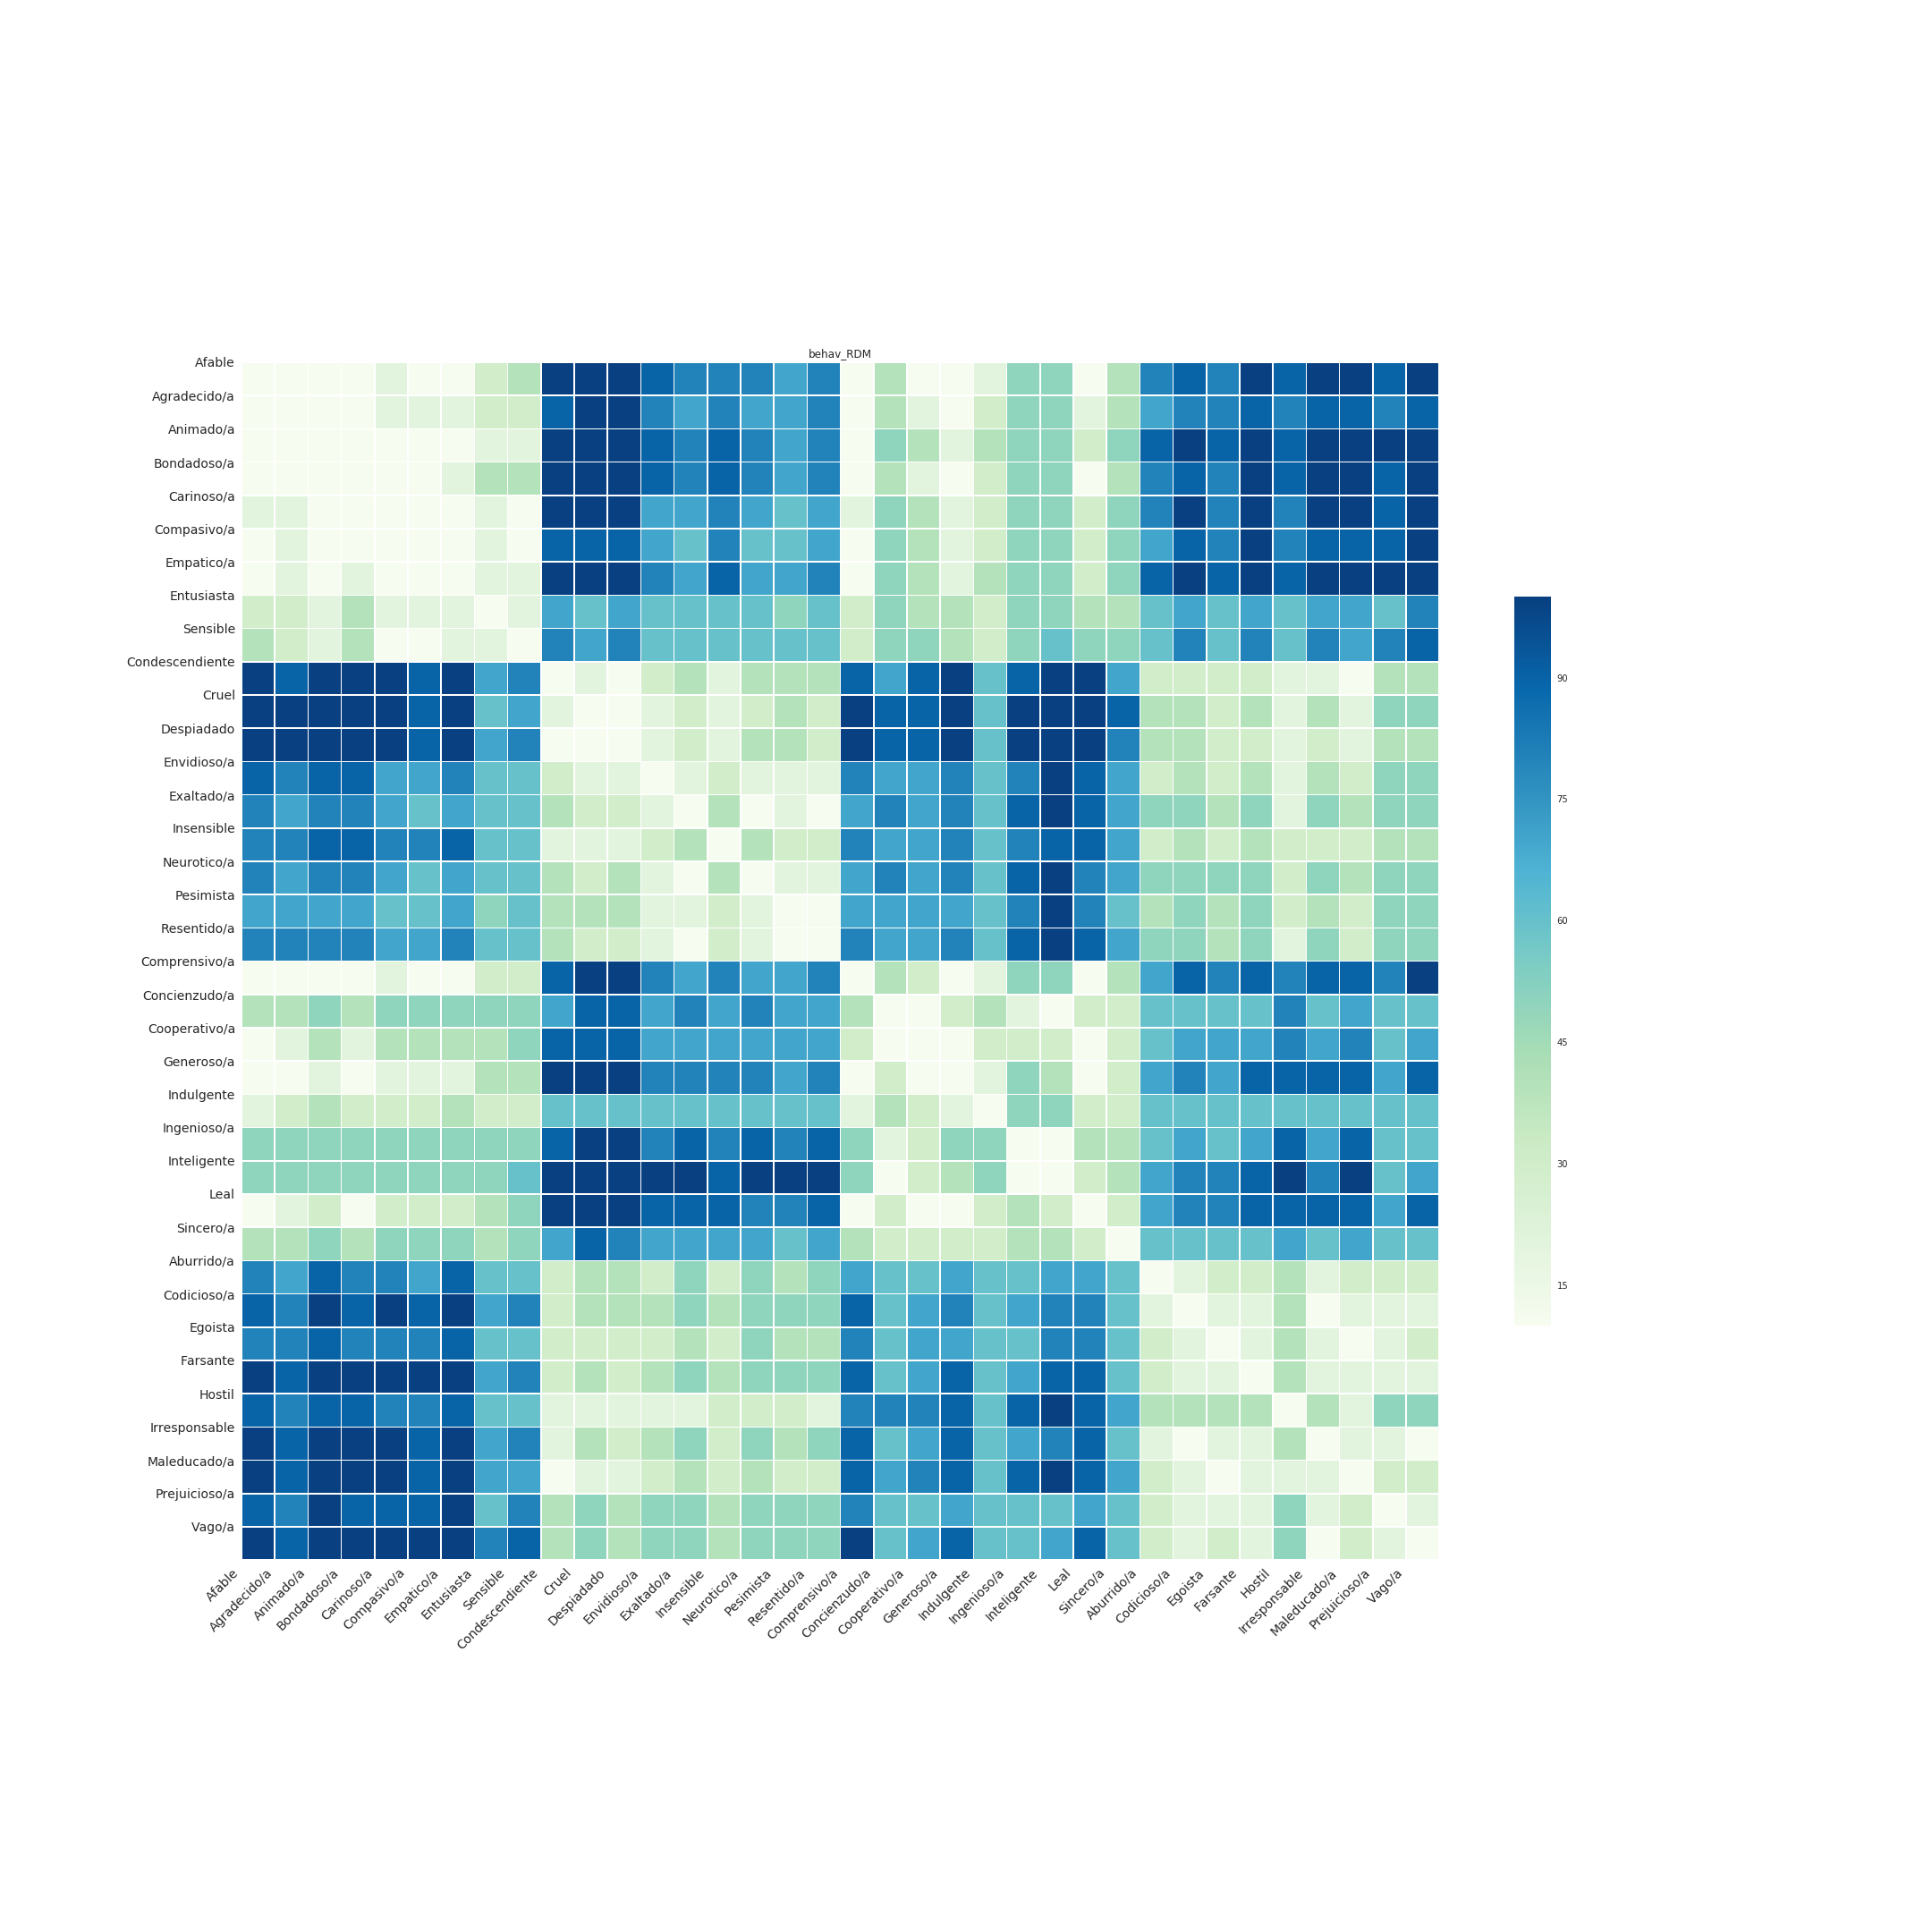
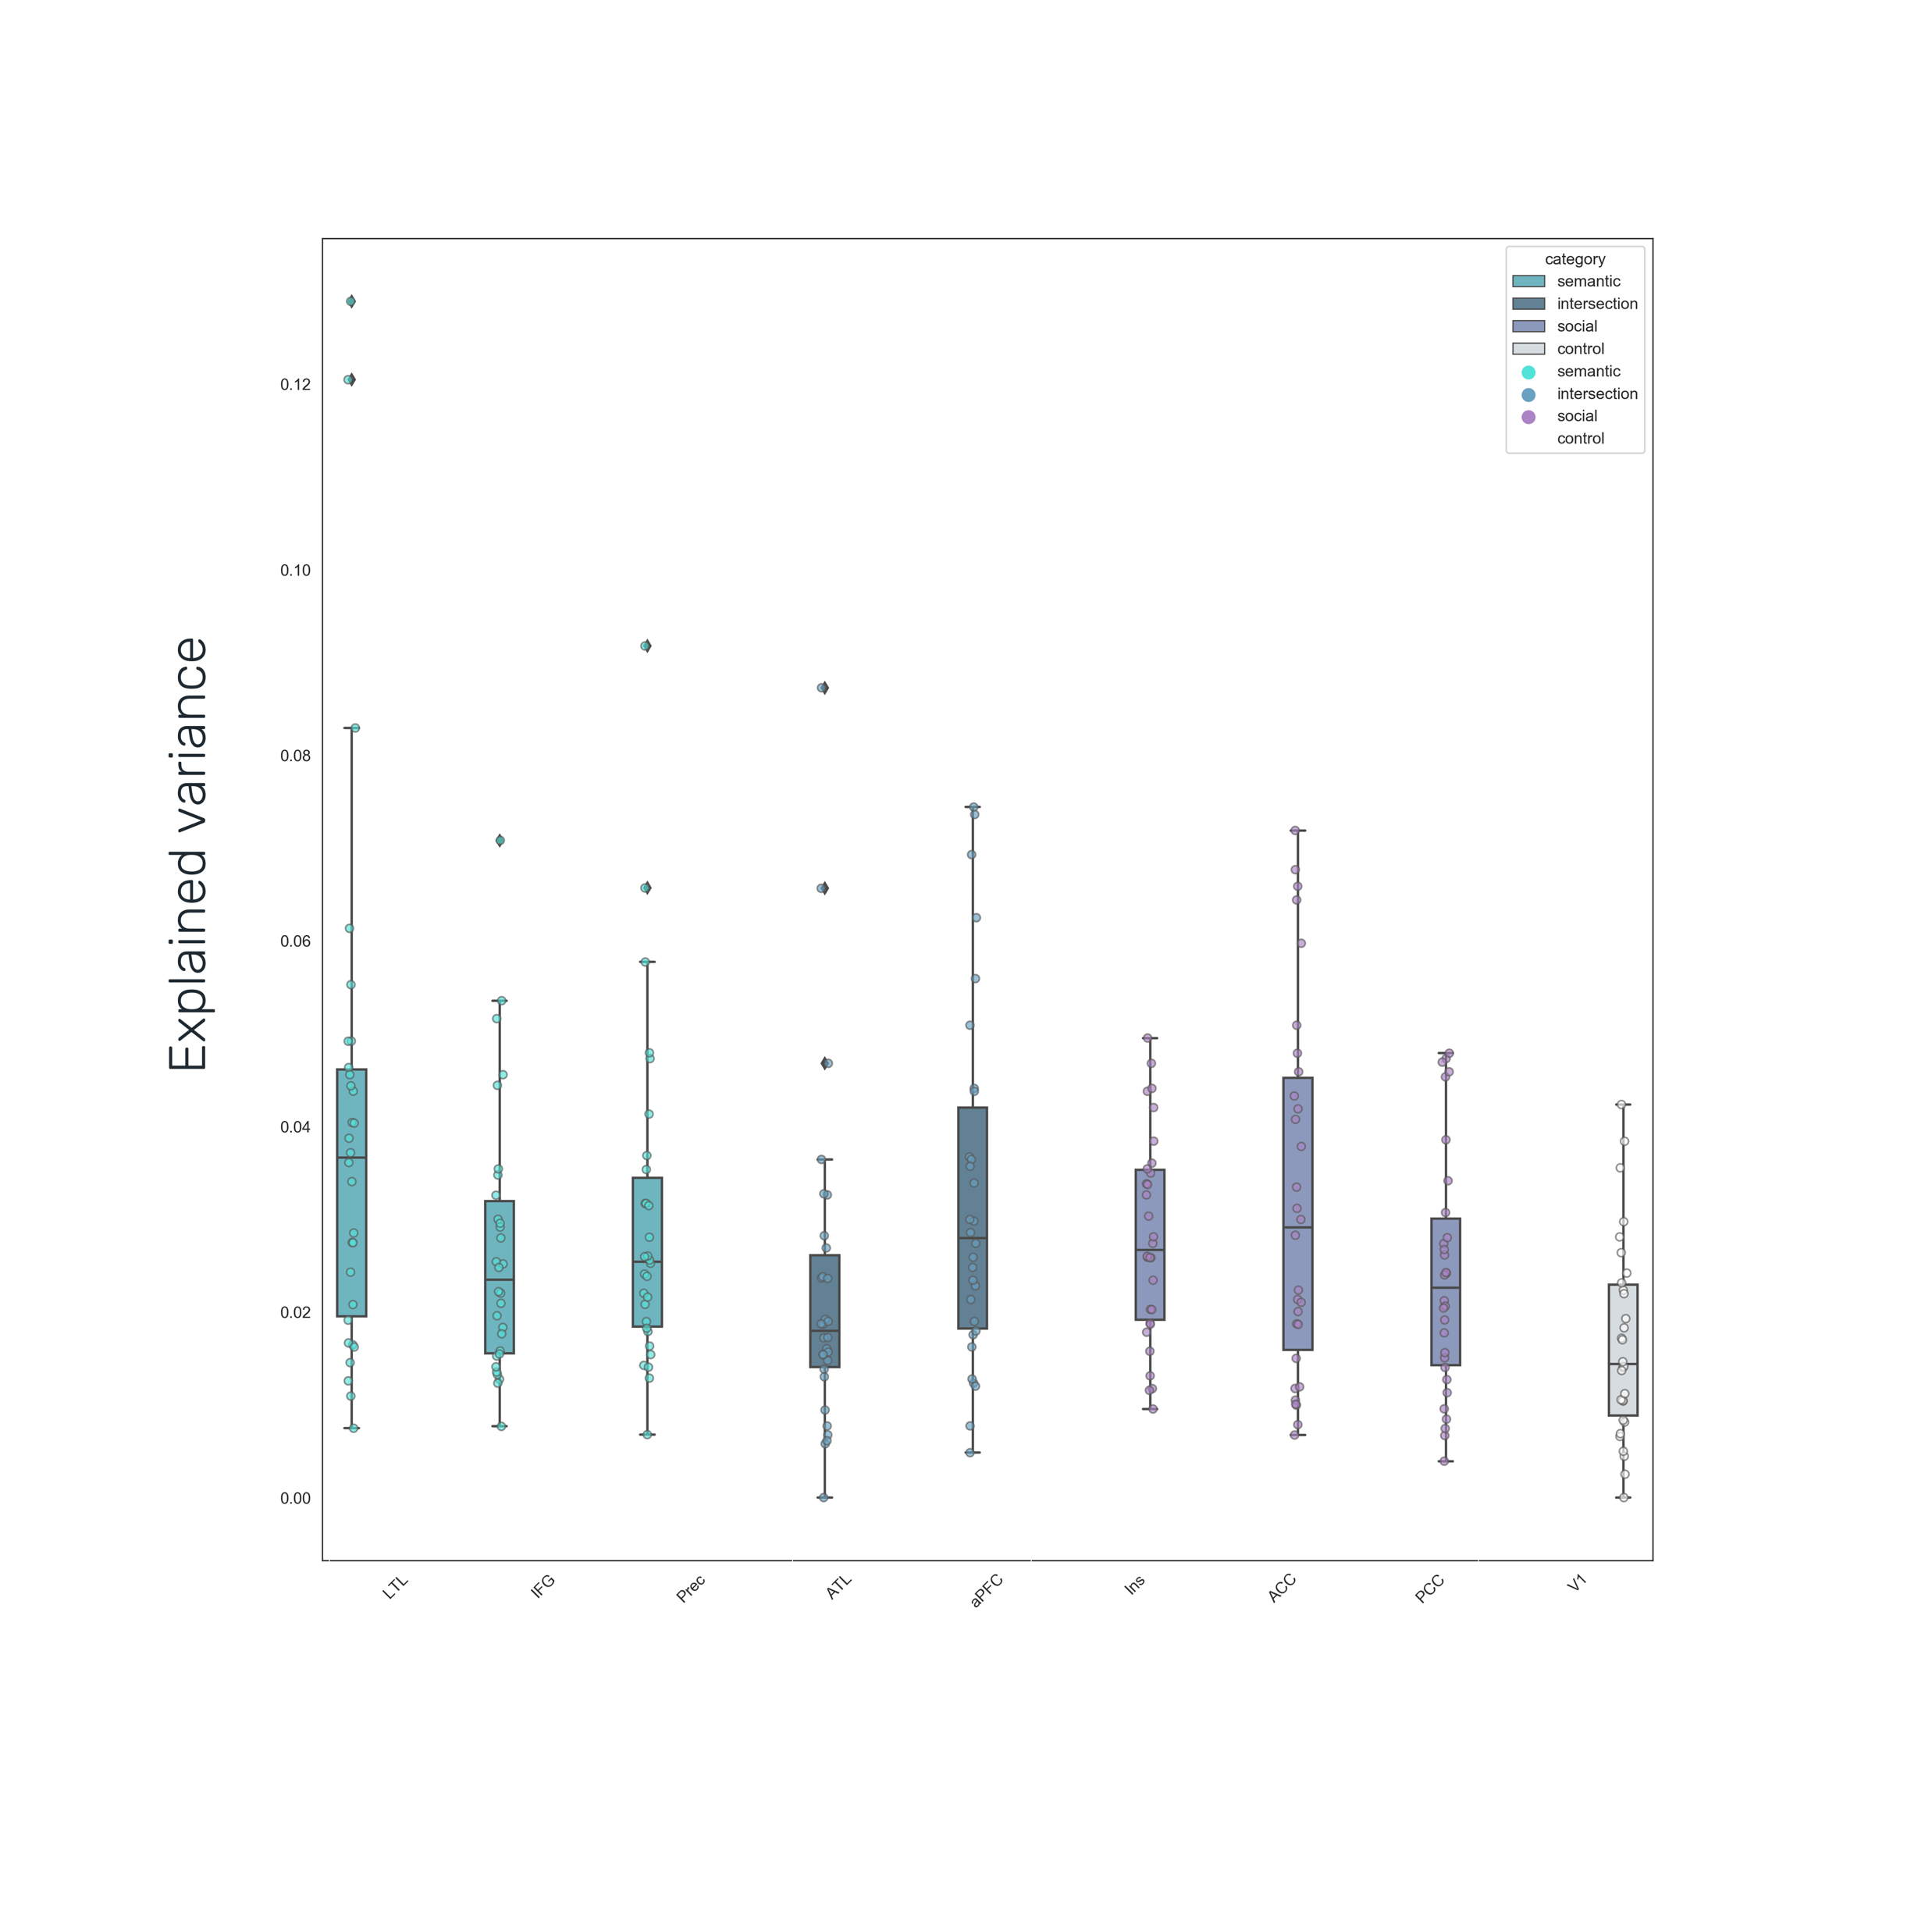
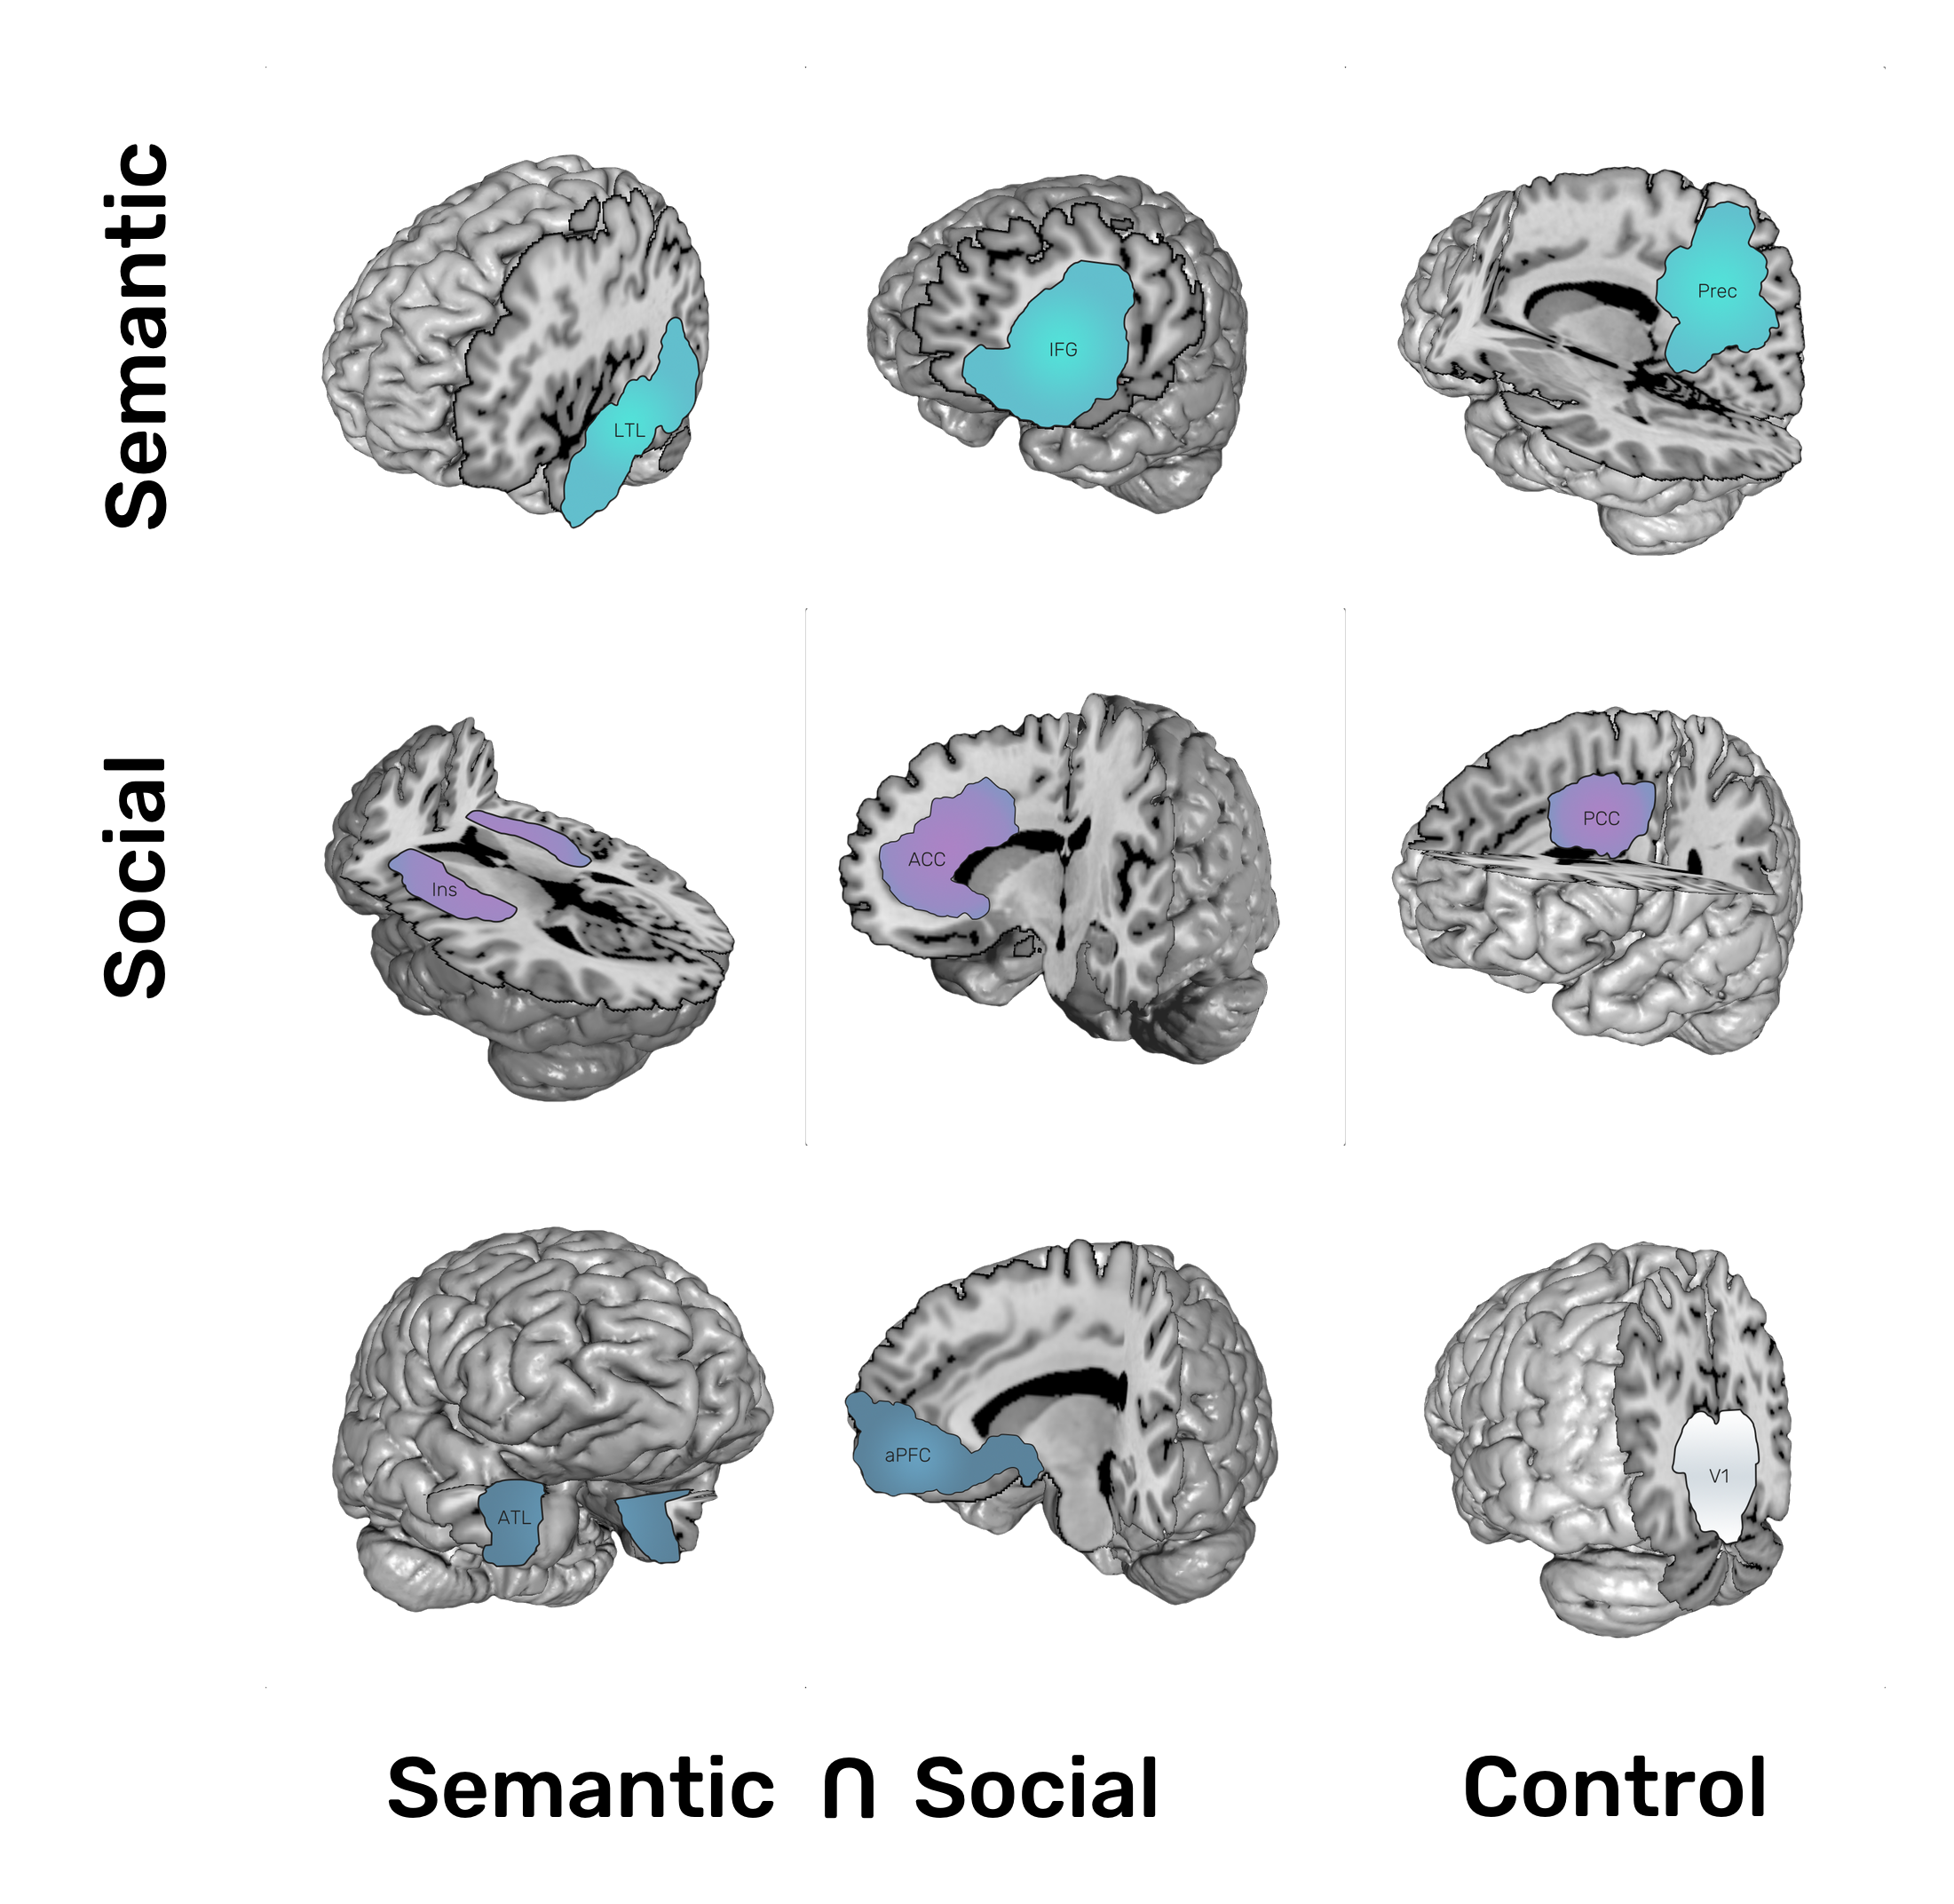
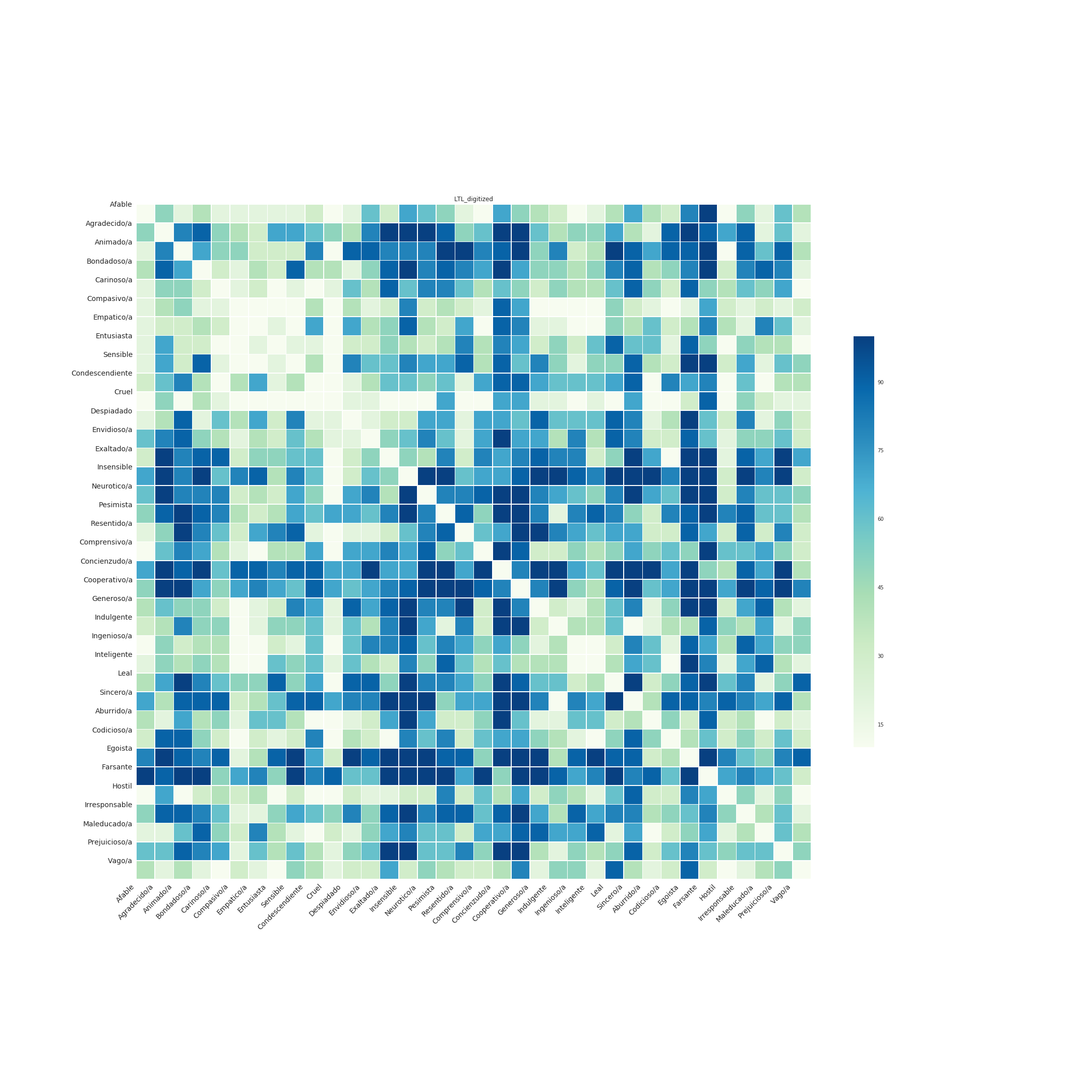
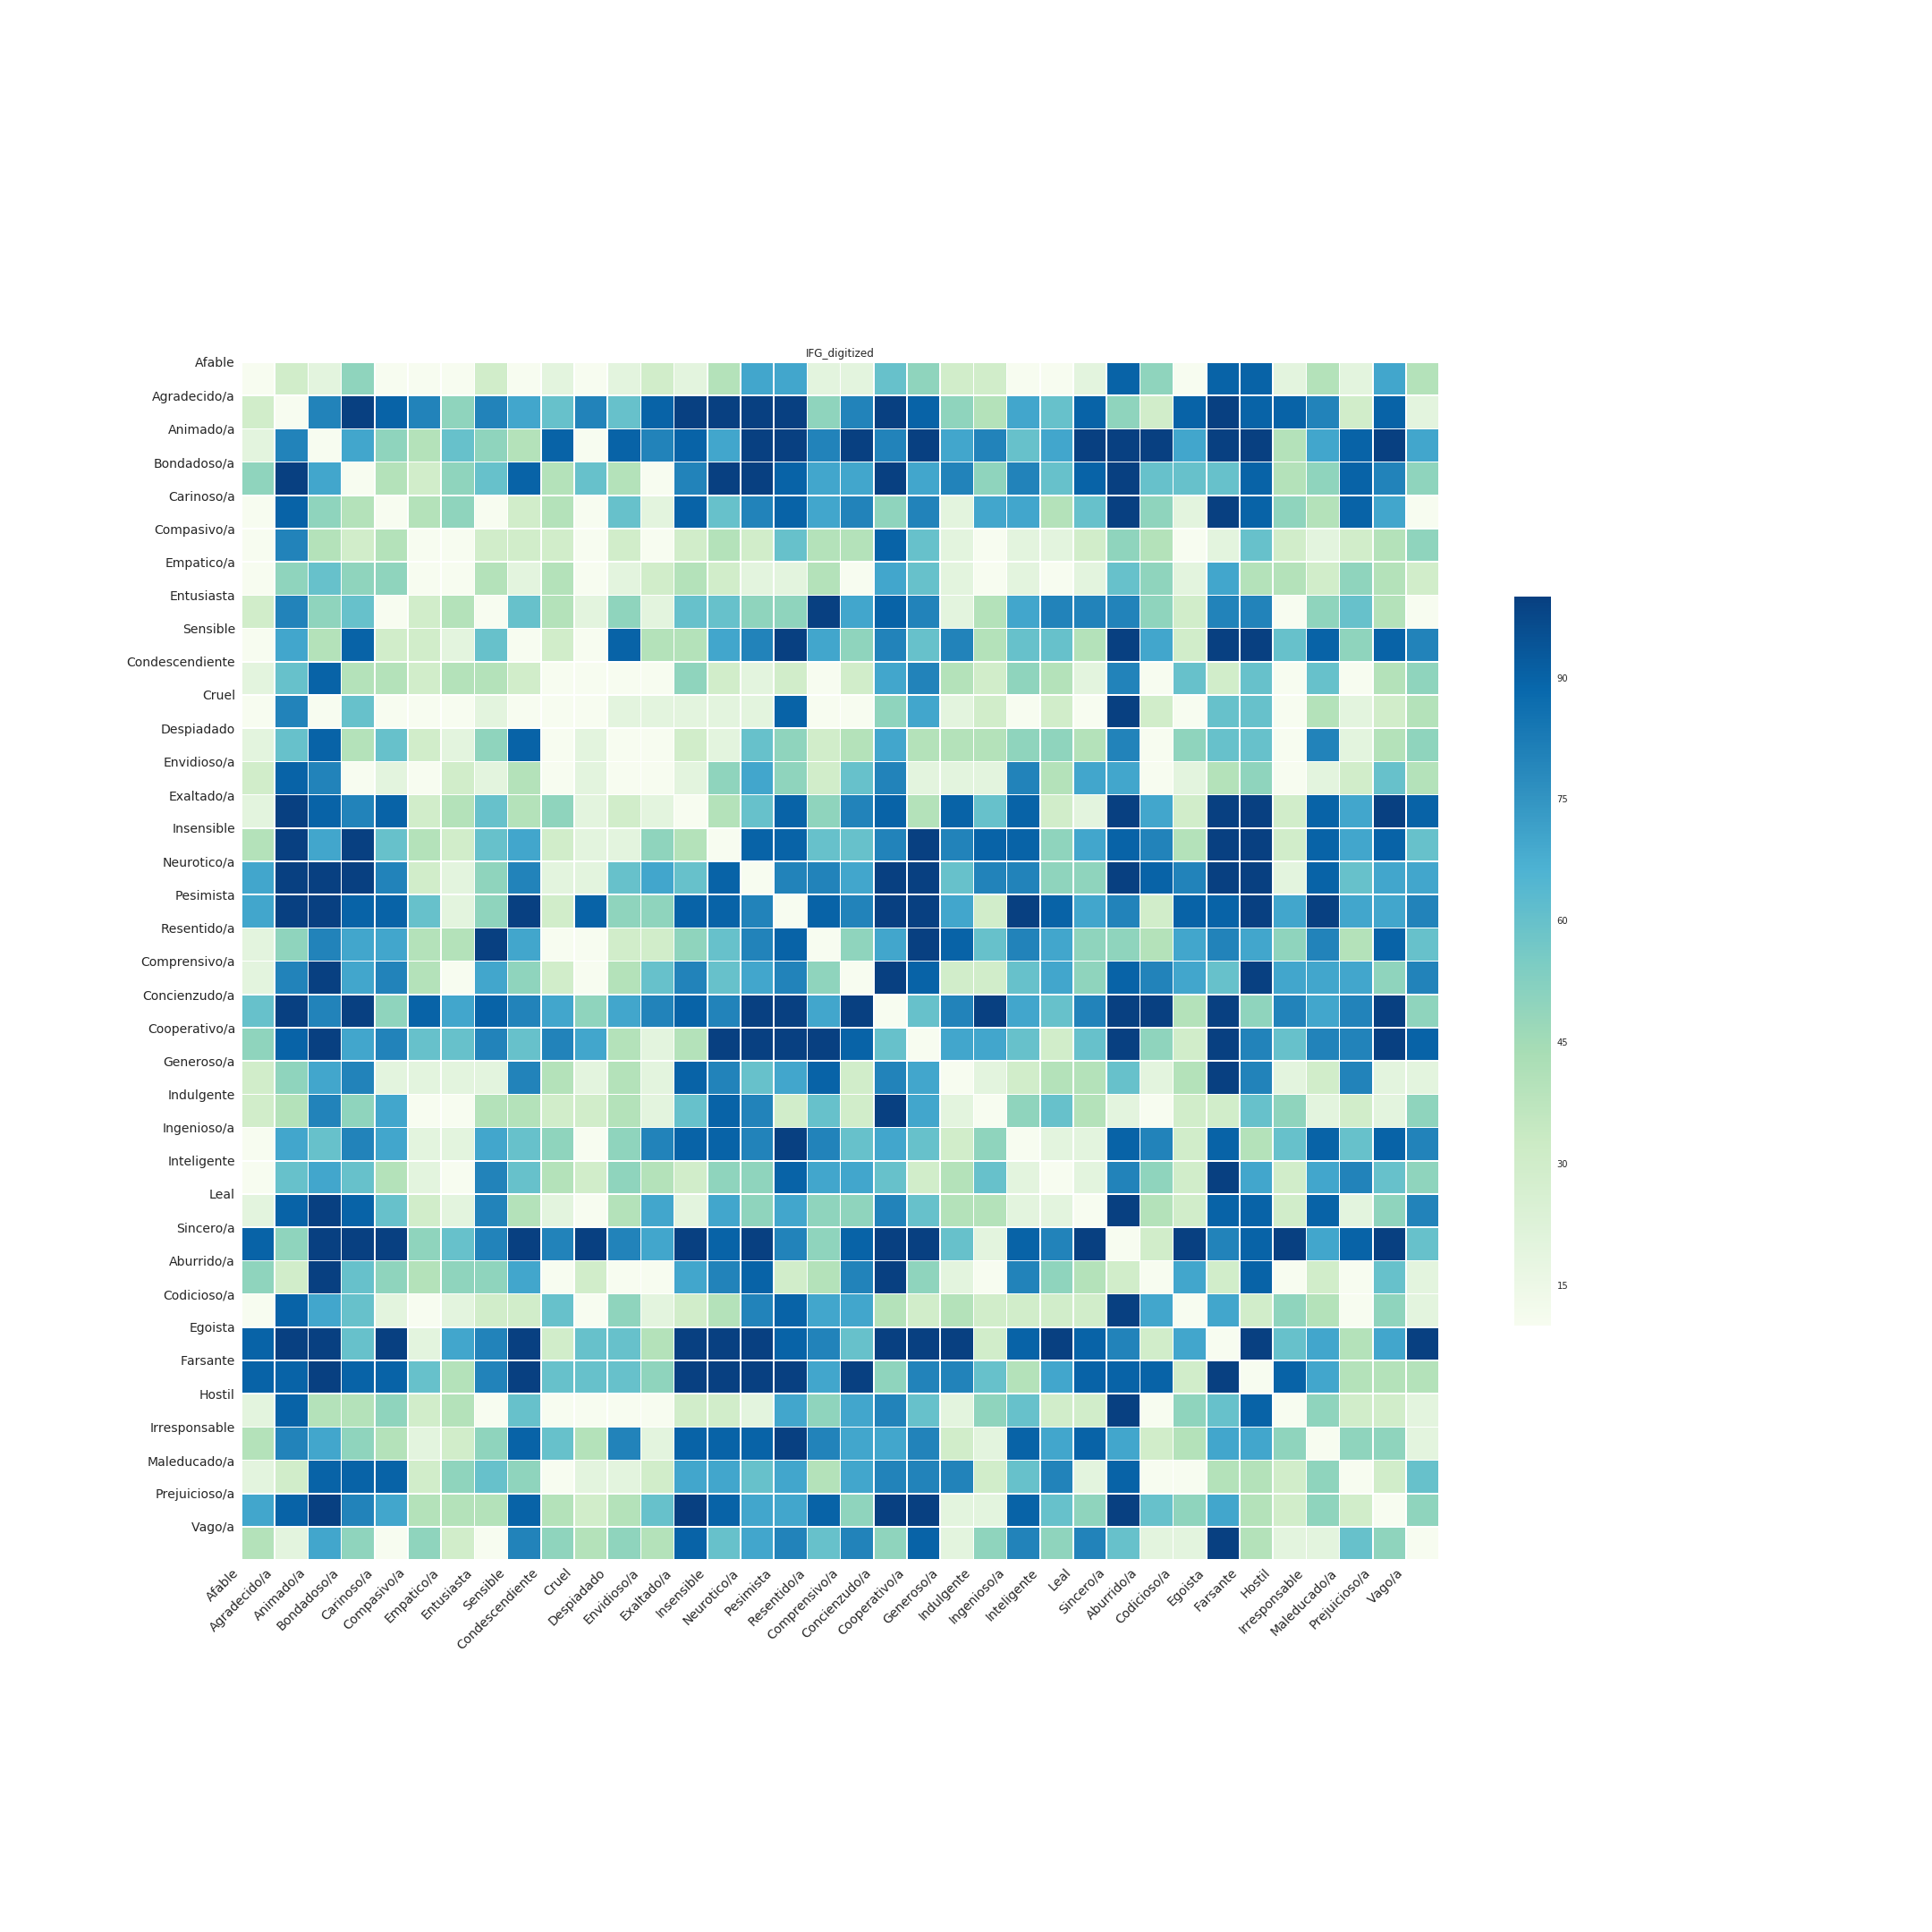
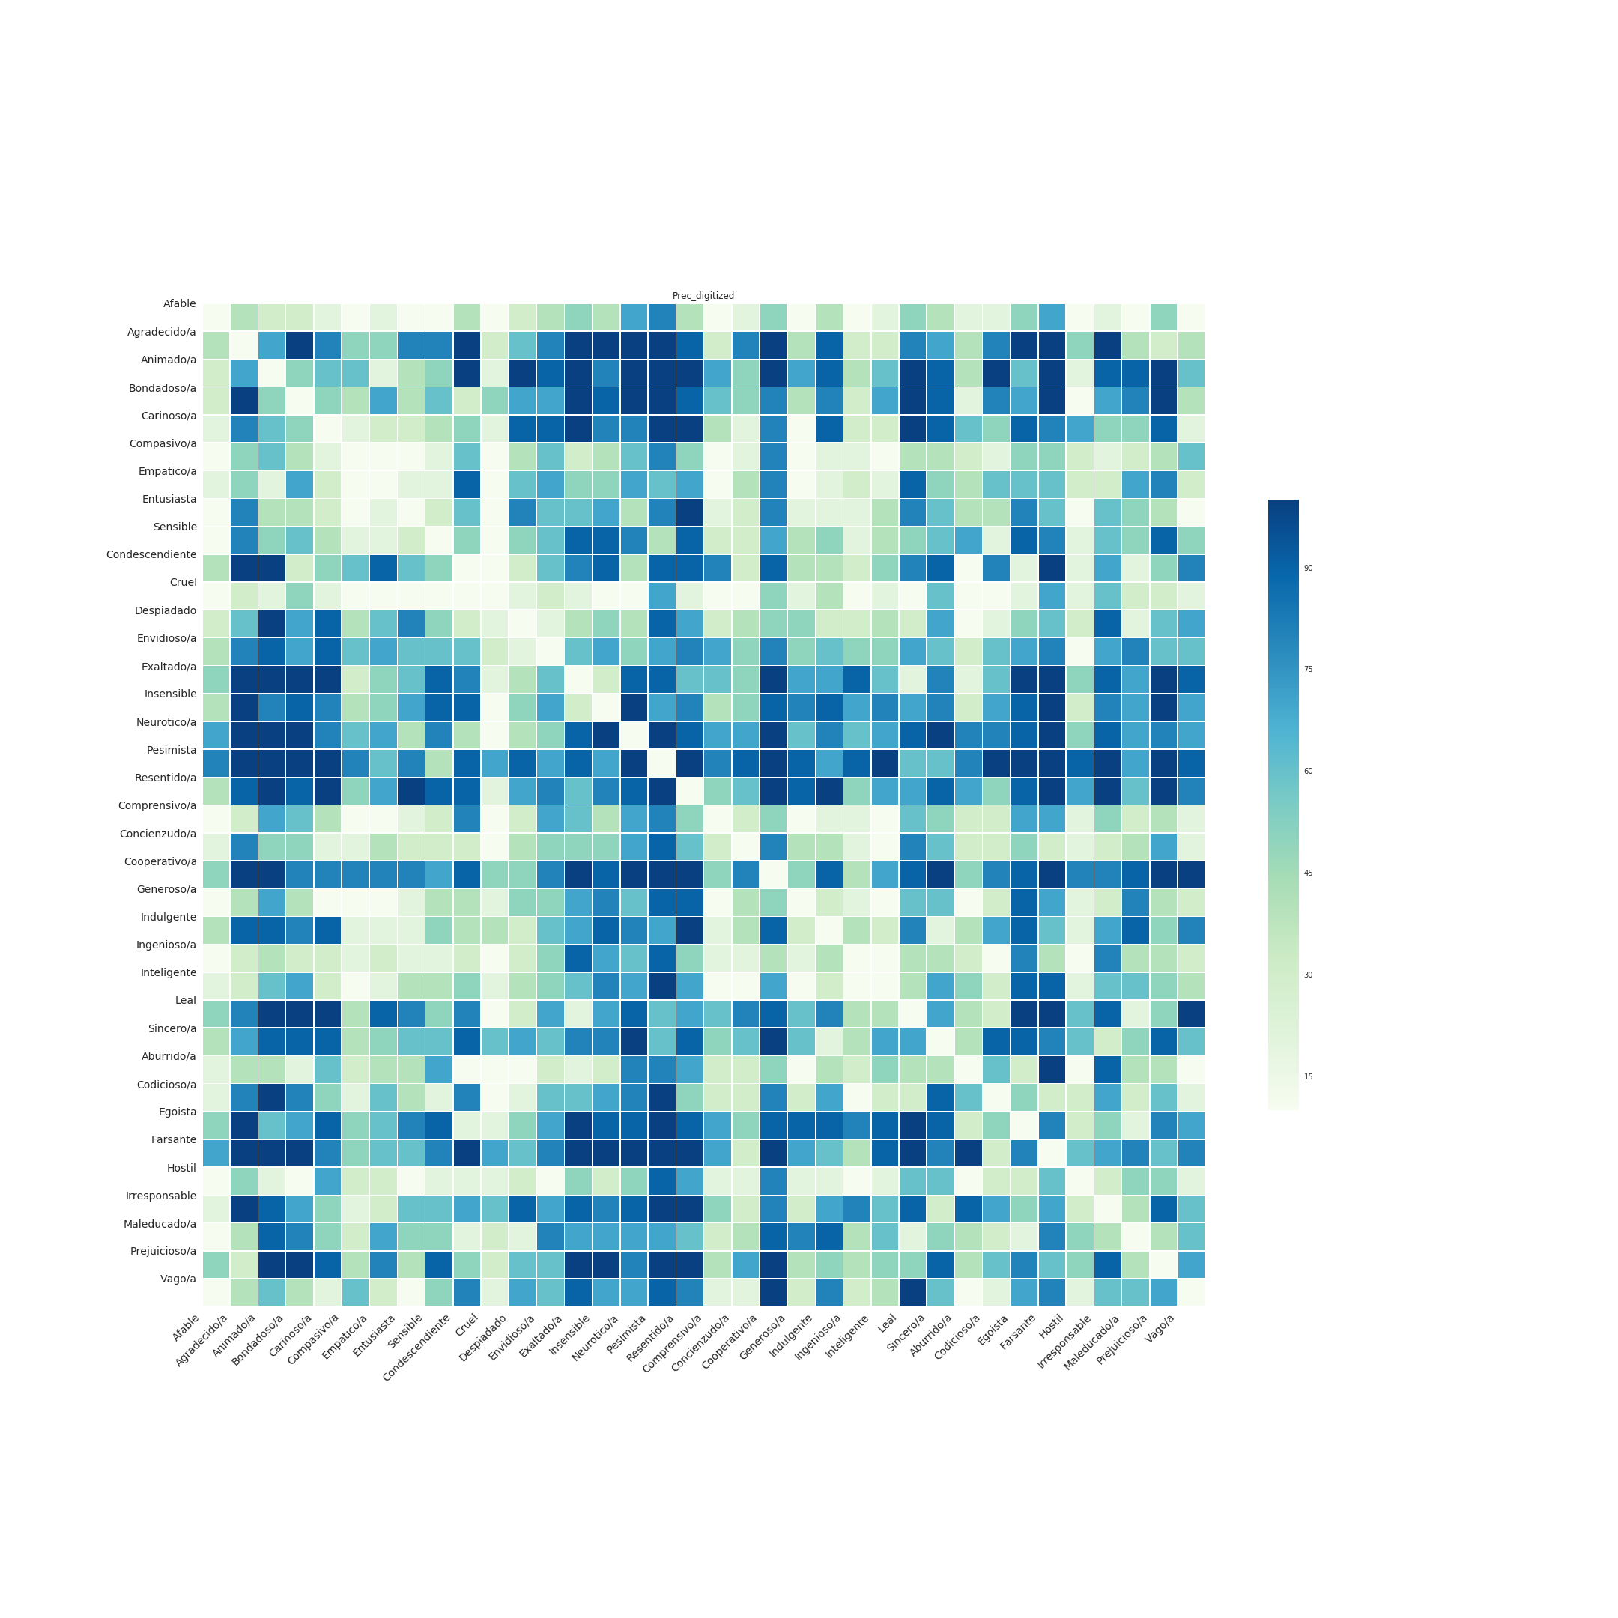
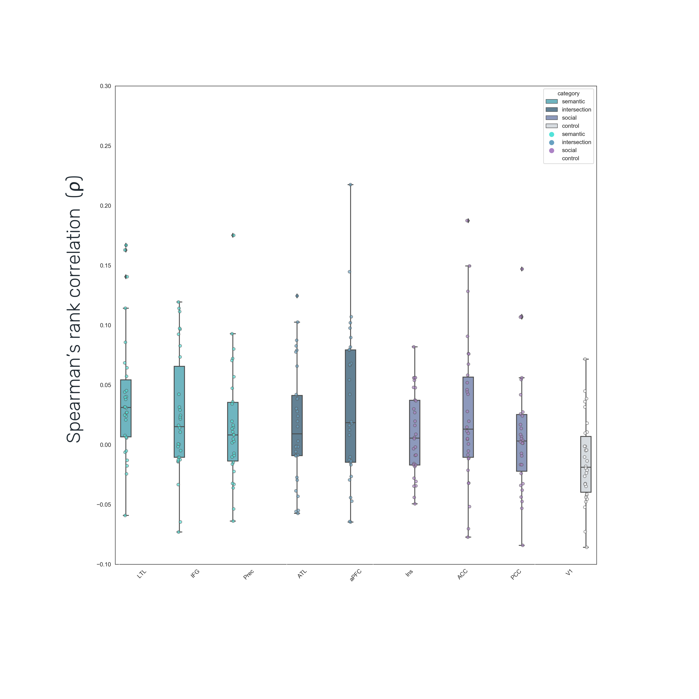
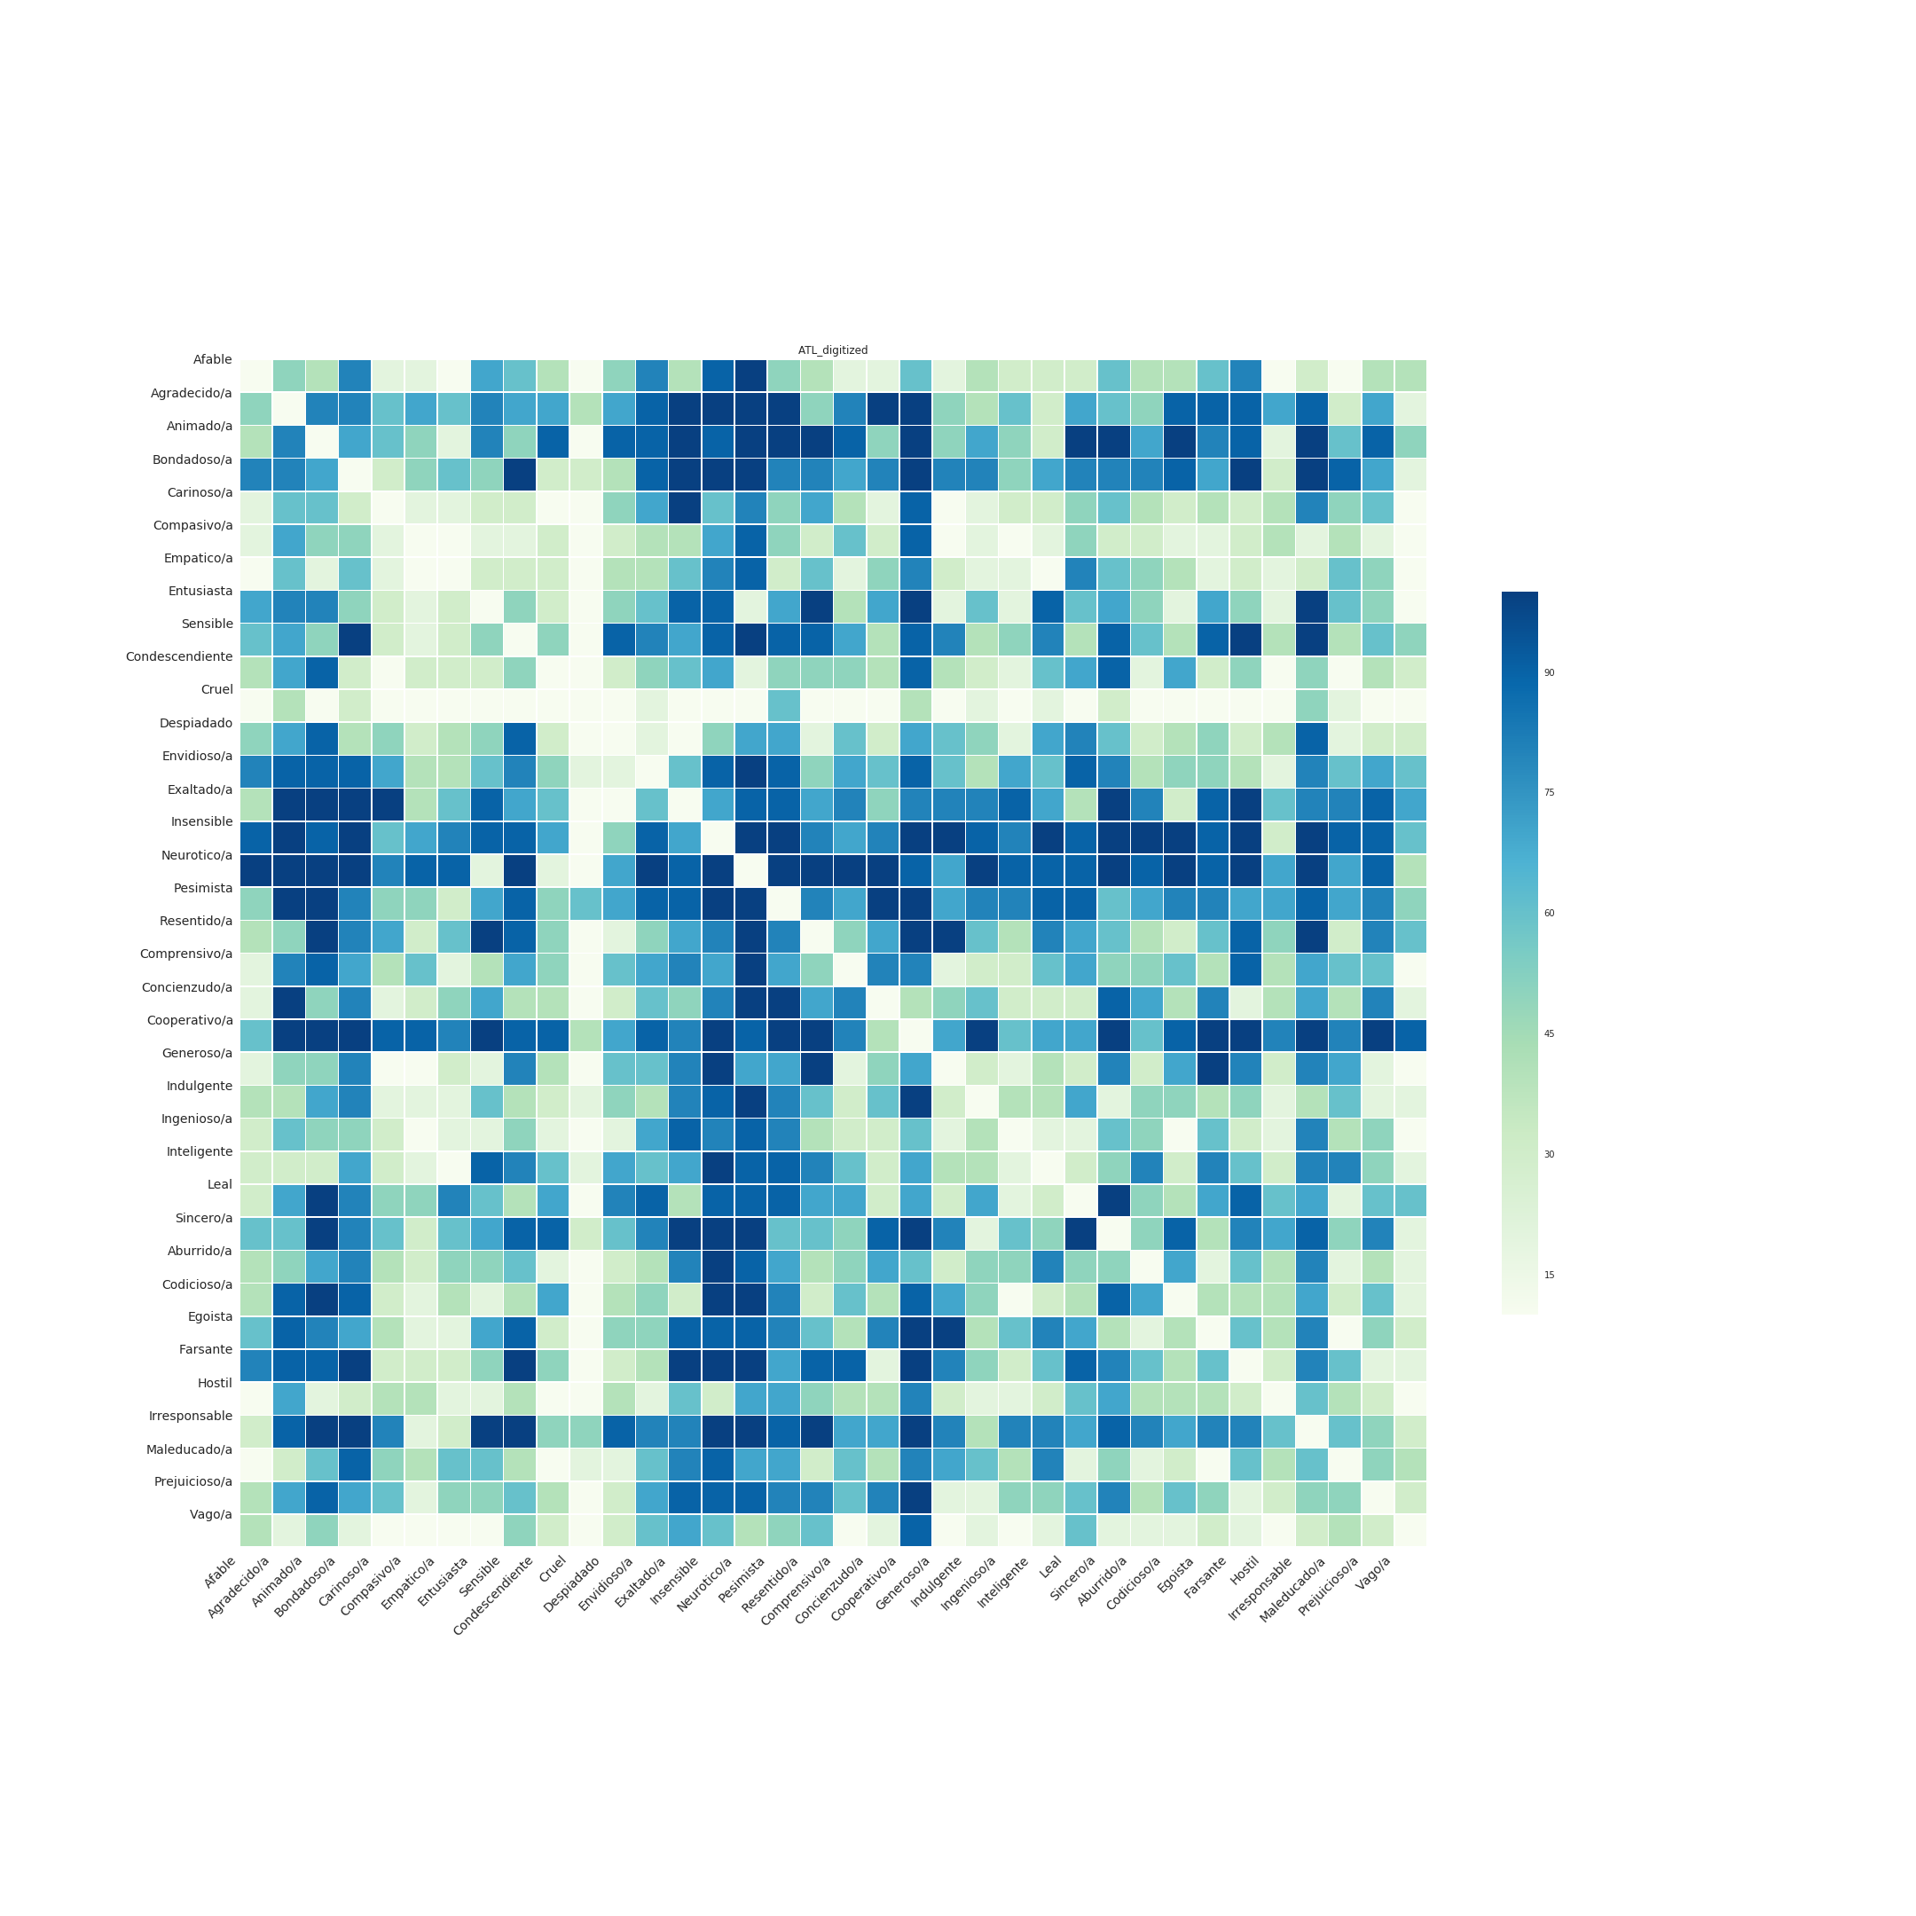
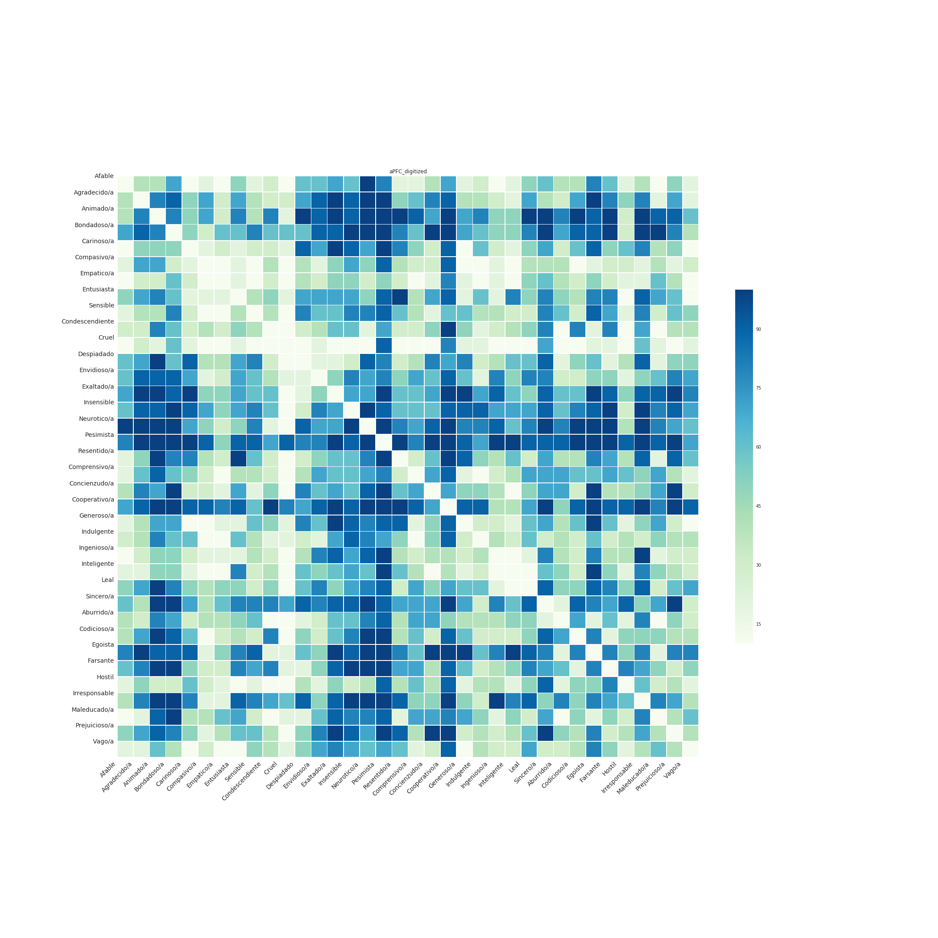
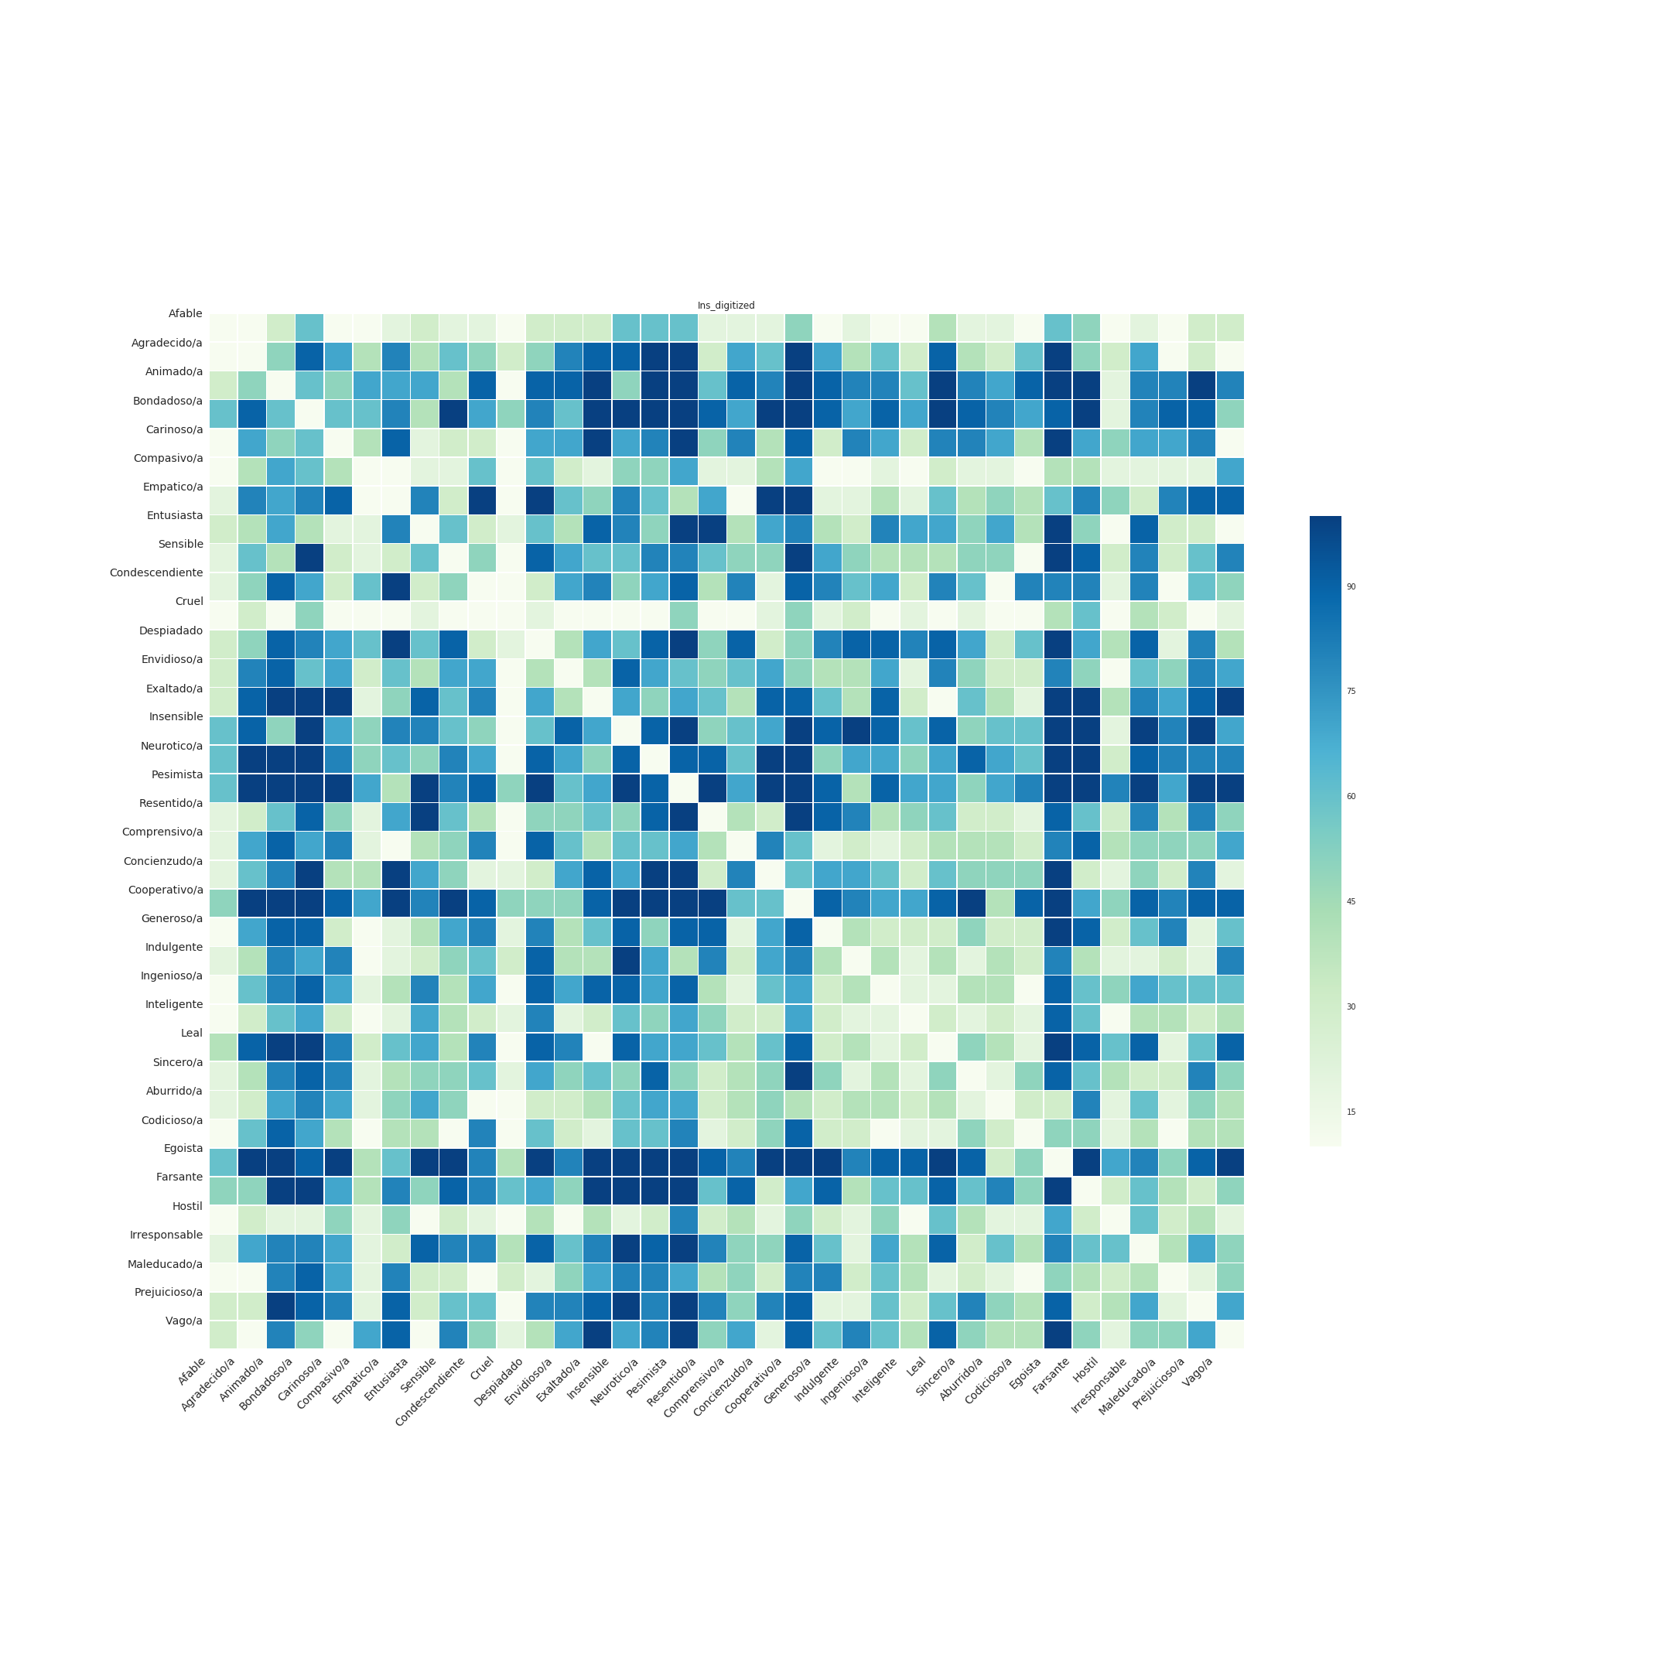
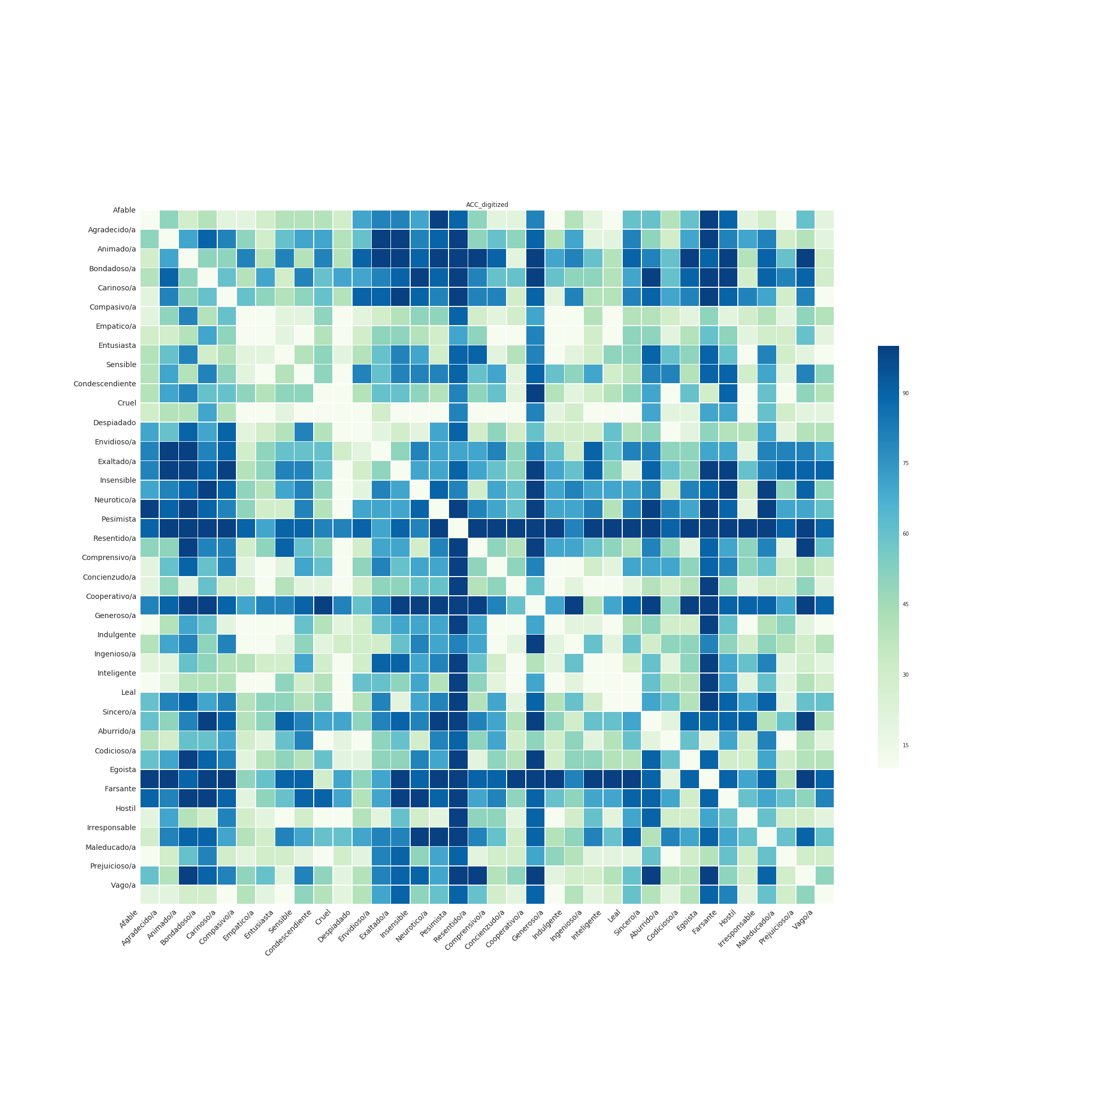
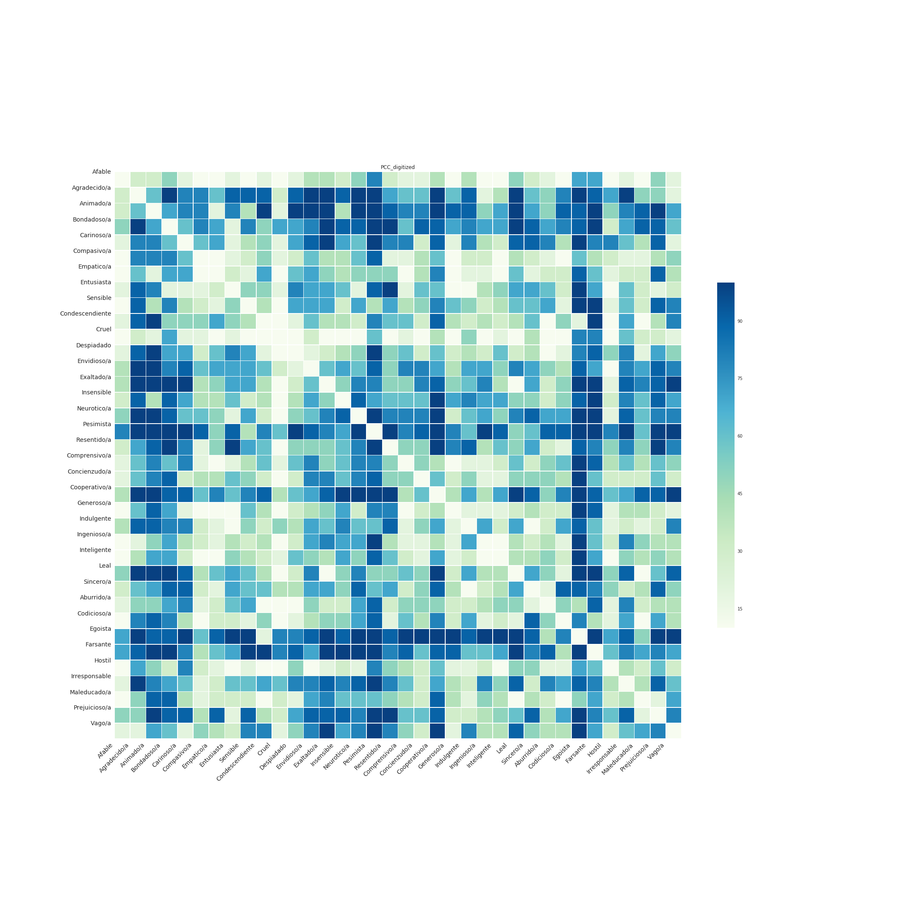
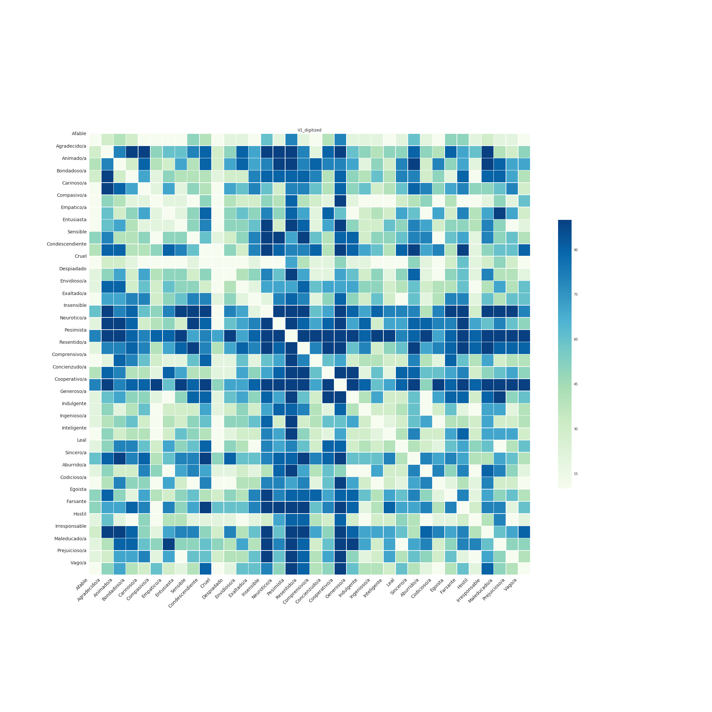
Brain representations of social knowledge during mental simulation
# TH852
Daniel Alcalá-López¹, David Soto^{1,2}
d.alcala@bcbl.eu
¹Basque Center on Cognition, Brain and Language (BCBL), Donostia – San Sebastian, Spain
²Ikerbasque, Basque Foundation for Science, Bilbao, Spain
@danalclop
Motivation
Decoding the brain representation of social concepts
How does the brain represent conceptual meaning about the behavior of
other individuals?
ID | Concept | Pre | Post | Class
sub-001 | Aburrido/a | 20 | 10 | likableness
sub-001 | Afable | 65 | 70 | likableness
sub-001 | Agradecido/a | 81 | 72 | likableness
sub-001 | Animado/a | 95 | 80 | likableness
… | … | … | …
sub-030 | Resentido/a | 50 | 70 | affect
sub-030 | Sensible | 100 | 95 | affect
sub-030 | Sincero/a | 50 | 50 | affect
sub-030 | Vago/a | 10 | 0 | affect
We have extensive evidence that we can use BOLD activity to classify conceptual knowledge using a variety of concrete concepts (e.g. animals or tools; JV Haxby 2012 Neuroimage).
Only recently there has been a similar interest in studying the brain representations of abstract concepts (M Ghio et al. 2016 Neuroimage; Y Wang et al. 2017 PNAS).
Abstract conceptual knowledge about others likely involves a range of underlying dimensions, yet it is unknown whether (and how) the brain maps different aspects of social information. We suggest and explore two candidate dimensions of interest for the study the representation of social information: affect and likableness (NH Anderson 1968 J Pers Soc Psychol).
ICC_{affect} = 0’47 [0,36-0,60]
ICC_{likableness} = 0’93 [0,89-0,96]
1
The intraclass correlation coefficient (ICC) shows that
test-retest reliability of the subjective ratings was fair
for affect ratings and excellent for likableness ratings.
The present study used MRI-based multivariate pattern analysis (MVPA) to investigate the brain representations of a specific type of abstract concepts: those we use to describe how others behave.
 | Sum of Squares | df | Mean Square | F | p | η²
ROI | 0.289 | 4.495 | 0.064 | 39.395 | < .001 | 0.576
CLASS | 0.034 | 1.000 | 0.034 | 7.801 | 0.009 | 0.212
ROI * CLASS | 0.037 | 5.699 | 0.006 | 7.640 | < .001 | 0.209
Methods
A repeated measures ANOVA with two factors (ROI,
9 levels; concept CLASS, 2 levels) shows that accuracies
are not uniform across ROIs and concept classes.
2
Behavioral ratings show that participants could clearly identify highly likable as well as highly unlikable social concepts (orange), whereas they rated the affective component of social concepts (blue) in a less unambiguous fashion.
We asked participants (n = 30) to rate on a scale from 0 to 100 how likable and affectionate was each social concept before and after the scanning.
4
Subjective ratings suggest that the likableness of others’ behavior weighs more heavily on how we represent social knowledge than its affection.
During the fMRI session participants listened to short definitions of social concepts and then mentally simulated another individual behaving the way it was described in the definition:
***
3
*
fixation
“Sabe razonar, resolver problemas
y comprender ideas complejas”
***
***
**
250 ms
delay
definition
500 ms
3 s
think
jitter
3 s
*
8 s
A scanning session was composed of 8 functional runs and a structural run halfway through the session.
Each functional run contained 36 trials
(one trial per social concept; 9 concepts for each concept class). A trial consisted on the auditory presentation of the definition of the social concept for 3 seconds followed by another short period of 3 seconds to mentally simulate the referred behavior.
LTL
IFG
Prec
ATL
aPFC
Ins
ACC
PCC
V1
semantic
social
LTL
IFG
Prec
ATL
aPFC
Ins
ACC
PCC
V1
affect
fMRI data was preprocessed as follows (i) removal of non-brain tissue using FSL’s BET; (ii) volume realignment using MCFLIRT; (iii) gaussian kernel (FWHM = 3mm) for spatial smoothing; (iv) ICA-based automatic removal of motion artefacts; (v) temporal filtering (high-pass; cutoff = 60s); (vi) coalignment of each session to a reference volume (1st session).
Decoding social concepts in a multi-class classification task shows
clear regional differences.
likableness
5
Semantic ROIs show in average a statistically higher classification
accuracy than social ROIs.
7
Decoding accuracies for the likableness classification task were
significantly higher than for the affect classification task.
6
8
We found a significant interaction effect between ROI and concept
class (likableness vs. affect) in the ACC.
After stacking, detrending, and z-scoring each ROI’s BOLD data we used an SVM-based linear classifier to decode the brain representation of social concepts regarding: (i) their likableness (high vs. low), (ii) their affect (high vs. low), as well as (iii) in a multi-class classification problem that included both dimensions of interest. We used a PCA-based feature selection within each ROI and leave-one-out cross-validation (300 permutations).
Further exploration of subjective ratings
Encoding model
Statistical significance of decoding performance at the group level was assessed using a one-sample t-test across subjects, corrected by the number of ROIs.
We used the subjective ratings to create a voxel-based encoding model of our social concepts.
We focused on a set of regions of interest (ROIs) based on previous studies on semantic (JR Binder et al. 2009 Cereb Cortex) and social information processing (D Alcalá-López et al. 2017 Cereb Cortex):
percentile (r)
The results from fitting the model to the voxels of each ROI are congruent with our previous decoding approach.
+ 3 semantic regions (lateral temporal
lobe, LTL; inferior frontal gyrus, IFG;
and precuneus, Prec)
+ 3 social regions (insula, Ins;
anterior cingulate cortex, ACC;
posterior cingulate cortex, PCC)
LTL
IFG
Prec
+ 2 semantic & social regions
(anterior temporal lobe, ATL;
anterior prefrontal cortex, aPFC)
ATL
aPFC
Ins
LTL
IFG
Prec
ATL
aPFC
Ins
ACC
PCC
V1
+ 1 control region
(primary visual cortex, V1)
ACC
PCC
V1
We then used the subjective ratings to create a 2D space that characterized the dissimilarity patterns between each pair of social concepts.
Representational Similarity Analysis
Take-home messages
LTL
IFG
Prec
Looking at behavioral ratings we see that likableness seems to be the underlying feature driving (dis)similarity between social concepts.
Canonical semantic regions outperformed putative social regions when classifying distinct classes of conceptual knowledge about others. Particularly, the lateral temporal lobe (LTL) contains especially rich social information.
The anterior cingulate cortex (ACC) shows a clear preference to classify the likableness of a social concept. Can this be a consequence of the saliency of this conceptual domain?
ATL
aPFC
Ins
We assessed the correspondence between the representational dissimilarity matrices of BOLD data for each ROI with behavior using Spearman’s rank correlation.
Alcalá-López, D., Smallwood, J., Jefferies, E., Van Overwalle, F., Vogeley, K., Mars, R. B., ... & Bzdok, D. (2017). Computing the social brain connectome across systems and states. Cerebral cortex, 28(7), 2207-2232. | Anderson, N. H. (1968). Likableness ratings of 555 personality-trait words. Journal of personality and social psychology, 9(3), 272. | Binder, J. R., Desai, R. H., Graves, W. W., & Conant, L. L. (2009). Where is the semantic system? A critical review and meta-analysis of 120 functional neuroimaging studies. Cerebral Cortex, 19(12), 2767-2796. | Haxby, J. V. (2012). Multivariate pattern analysis of fMRI: the early beginnings. Neuroimage, 62(2), 852-855. | Ghio, M., Vaghi, M. M. S., Perani, D., & Tettamanti, M. (2016). Decoding the neural representation of fine-grained conceptual categories. Neuroimage, 132, 93-103. | Wang, Y., Collins, J. A., Koski, J., Nugiel, T., Metoki, A., & Olson, I. R. (2017). Dynamic neural architecture for social knowledge retrieval. Proceedings of the National Academy of Sciences, 114(16), E3305-E3314.
ACC
PCC
V1
LTL
IFG
Prec
ATL
aPFC
Ins
ACC
PCC
V1

